Slide 1
U.S. PIAAC Prison Study

Slide 2
What is the PIAAC Prison Study?
A nationally representative survey of the skills of incarcerated adults
Administered in 2014
to 1,300 incarcerated adults ages 18-74
at 98 state and federal prisons
Female-only prisons oversampled to permit analyses with data from incarcerated women

Slide 3
Previous U.S. Prison Studies
1992 National Adult Literacy Survey (NALS)
First in-person literacy assessment with U.S. prison population
1,100 inmates from 80 federal and state prisons
2003 National Assessment of Adult Literacy (NAAL)
1,200 adults incarcerated in state and federal prisons
Conducted in 107 prisons (including 12 federal prisons) in 31 states
Notes:
NCES has conducted two previous prison studies—in the early 1990s and in the early 2000s—focused on the skills of the inmate population in the United States. Thus, the PIAAC prison study is the third such study of the U.S. incarcerated population.
Currently, the results of the PIAAC study cannot be compared to the results published for the earlier studies because the earlier studies have not yet been converted to the PIAAC scale. However, once the older results are put on the PIAAC scale, comparisons will be possible.

Slide 4
How was the PIAAC U.S. Prison Study conducted?
Mode of assessment: Laptop computer or Paper-and-Pencil
Time: Approximately 2 hours
Background Questionnaire (45 minutes)
Assessment Core (5 minutes)
Assessment Items (60 minutes)
Background questionnaire
Focused on inmates’ participation in prison-specific programs and activities
Conducted either in English or Spanish
Notes:
Bilingual interviewers conducted the prison-specific background questionnaire on a laptop computer.
Explain the BQ, here is an explanation to consider using:
The Background Questionnaire or BQ was same as Household questions with some changes related to prison-specific programs and activities. Questions included
general information about inmates’ sociodemographic characteristics, as well as questions specifically related to their life in prison, such as participation in prison jobs, training and education within prison.

Slide 5
How was the PIAAC U.S. Prison Study conducted? (cont.)
Direct Assessment:
1. The same direct assessment used in the Household Study was used in the Prison Study:
Literacy: Both paper-and-pencil and computer versions
Numeracy: Both paper-and-pencil and computer versions
Problem solving in technology-rich environments: Only on computer
Reading components: Only paper-and-pencil
2. Adaptive: Items targeted to respondents’ performance
Notes:
After completing the BQ, inmates who were familiar with computers, and who were willing to take an online version of the assessment, took the direct assessment on the laptop computer; the remaining inmates took the paper-and-pencil version of the assessment.
The same direct assessment used in household study was used in Prison Study
Literacy: both paper & pencil and computer versions
Numeracy: both paper & pencil and computer versions
Problem solving in technology-rich environments: only on computer
Reading components: only paper & pencil
The majority of inmates took the direct assessment on the laptop.

Slide 6
Profile of U.S. Incarcerated Adults

Slide 7
Profile of U.S. Incarcerated Adults
Percentage of U.S. adults in U.S. Prison and U.S. Household populations, by selected characteristics: 2012 and 2014
Characteristic | Percentage
 | U.S. Prison | U.S. Household
Gender
Male | 93* | 49
Female | 7* | 51
Race/ethnicity
White | 34* | 66
Black | 37* | 12
Hispanic | 22* | 14
Other | 7 | 7
* Significantly different (p < .05) from the comparison category: U.S. Household.
Notes:
The U.S. prison population had significantly more males and significantly fewer females than the household population. In addition, there were significantly more Black and Hispanics in the Prison population than the household population.

Slide 8
Profile of U.S. Incarcerated Adults (cont.)
Percentage of U.S. adults in U.S. Prison and U.S. Household populations, by selected characteristics: 2012 and 2014
Characteristic | Percentage
 | U.S. Prison | U.S. Household
Age intervals¹
16-24 | 13* | 17
25-34 | 35* | 18
35-44 | 24* | 18
45-54 | 19 | 20
55-65 | 8* | 18
66-74 | 1* | 9
Born in the United States
Yes | 93* | 86
No | 7* | 14
* Significantly different (p < .05) from the comparison category: U.S. Household. ¹ While the PIAAC target population consisted of 16- to 74-year-olds, the prison sample did not include 16- or 17-year-olds.
Notes:
The prison population was generally younger than the household population. There were significantly more individuals between the ages of 25-44 in the prison population in comparison to the wider U.S. population. In addition, the prison population contained significantly more native U.S. citizens than the wider household population. Compared to household population, a higher percentage of incarcerated population were native-born.

Slide 9
Profile of U.S. Incarcerated Adults (cont.)
Percentage of U.S. adults in U.S. Prison and U.S. Household populations, by selected characteristics: 2012 and 2014
Characteristic | Percentage
 | U.S. Prison | U.S. Household
Highest level of educational attainment
Graduate or professional degree | 1* | 11
Bachelor's degree | 1* | 17
Associate's degree | 4* | 9
High school credential | 64* | 50
Below high school | 30* | 14
Recidivism
First time in prison | 27 | n/a
Previously incarcerated | 73 | n/a
* Significantly different (p < .05) from the comparison category: U.S. Household.
Notes:
The percentage of the prison population with a degree more advanced than high school was significantly lower than the percentage of adults in the household population. Similarly, the percentage of incarcerated with a level of education of high school or below was significantly higher than the percentage with that level of education in the household population.
73% of the prison population had been previously incarcerated.

Slide 10
PIAAC Prison Study Results
Skills of U.S. Incarcerated Adults Compared to the U.S. Household Sample

Slide 11
Incarcerated adults had lower average literacy scores (249) and numeracy scores (220) than the U.S. household population (270 and 255).
*
*
* Significantly different (p < .05) from the comparison category: U.S. Household.

Slide 12
Compared to U.S. households, a larger percentage of incarcerated adults performed at Level 1 and below in literacy (29% vs. 19%).
Percentage of adults ages 16-74 at each level of proficiency on the PIAAC literary scale: 2012 and 2014
19%
29%
Notes:
A large number of U.S. household population perform level 1 and below literacy (19%). However, a larger percentage of incarcerated adults performing at this level (29%).

Slide 13
Compared to U.S. households, a larger percentage of incarcerated adults performed at Level 1 and below in numeracy (52% vs. 29%).
Percentage of adults ages 16-74 at each level of proficiency on the PIAAC numeracy scale: 2012 and 2014
29%
52%
Notes:
In numeracy, average scores of incarcerated adults was significantly lower than the household population and higher percentages (52%) of incarcerated performed at Level 1 and below than their household peers.

Slide 14
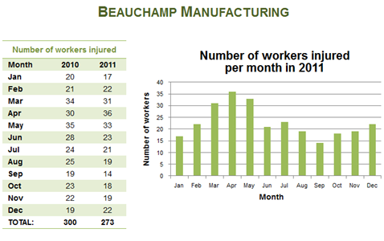
Numeracy example item: Level 2
The test-taker is presented with factory data for two years and a bar graph.
48% of the prison population are
likely to get this answer correct.
71% of the household population are
likely to get this answer correct.
Automotive Factory
Number of workers absent
In Year 2
Month | Year 1 | Year 2
Jan | 20 | 17
Feb | 21 | 22
Mar | 34 | 31
Apr | 30 | 36
May | 35 | 33
Jun | 28 | 23
Jul | 24 | 21
Aug | 25 | 19
Sep | 19 | 14
Oct | 23 | 18
Nov | 22 | 19
Dec | 19 | 22
Total | 300 | 273
Which two bars are incorrect?
The test-taker needs to compare the table to the bars in the chart and find two bars that do not match the data table.
The test-taker is asked to find two mistakes in the bar graph.
Note: Not an actual replica of test item
Notes:
For information on literacy levels and sample items, please see “Sample PIAAC Tasks” at the following link: http://piaacgateway.com/s/7-Sample-Tasks113014AIRlogofinal12814.pptx

Slide 15
Numeracy example item: Level 3
14% of the prison population are
likely to get this answer correct.
38% of the household population are likely to get this answer correct.
The test-taker is presented with information about a shoe sale.
Running Shoes
SALE! Buy one pair – get the second
(of equal or lesser value) for half price!
How much would you pay if you bought both pairs on sale?
$
48.95
The test-taker is asked to calculate the total amount one would need to pay for both shoes during the sale.
The test-taker needs to calculate and enter the correct dollar amount for the two pairs of shoes on sale.
Note: Not an actual replica of test item

Slide 16
Descriptions of the PIAAC proficiency levels for numeracy (defining what adults can do at each level)
Level 5
(376-500)
Level 4
(326-375)
Perform basic tasks: counting, arithmetic operations with whole numbers.
Perform one-step tasks: count; sort; arithmetic operations; understanding simple percentages: example: 50%.
Perform two or more calculations, simple measurement; spatial representation; estimation; and interpret simple tables, graphs.
Understand and work with mathematical patterns, proportions, basic statistics expressed in verbal or numerical form.
Understand complex abstract mathematical and statistical ideas embedded in complex texts, draw inferences; arguments or models; justify, reflect on solutions or choices.
Perform analysis, complex reasoning, statistics and chance; spatial relationships; and communicating well-reasoned explanations for answers.
Level 3
(276-325)
Level 2
(226-275)
Level 1
(176-225)
Below Level 1 (0-175)
Notes:
let’s look at levels. The numeracy average is solidly in level 1
Below Level 1: Adults at this level can only cope with very simple tasks set in concrete, familiar contexts where the mathematical content
is explicit and that require only simple processes such as counting; sorting; performing basic arithmetic operations with
whole numbers or money, or recognizing common spatial representations. Adults who score less than 176 points are
considered to be below Level 1.
Level 1: Adults at Level 1 can complete tasks involving basic mathematical processes in common, concrete contexts where the
mathematical content is explicit with little text and minimal distractors. They can perform one-step or simple processes
involving counting, sorting, basic arithmetic operations, understanding simple percents, and locating and identifying
elements of simple or common graphical or spatial representations.
Level 2: Adults at this level can successfully perform tasks that require identifying and acting upon mathematical information and
ideas embedded in a range of common contexts where the mathematical content is fairly explicit or visual with relatively
few distractors. The tasks may require applying two or more steps or processes involving, for example, calculations
with whole numbers and common decimals, percents and fractions; simple measurement and spatial representations;
estimation; or interpreting relatively simple data and statistics in texts, tables and graphs.
Level 3: Adults at Level 3 can successfully complete tasks that require an understanding of mathematical information that may
be less explicit, embedded in contexts that are not always familiar, and represented in more complex ways. They can
perform tasks requiring several steps and that may involve a choice of problem-solving strategies and relevant processes.
They have a good sense of number and space; can recognize and work with mathematical relationships, patterns, and
proportions expressed in verbal or numerical form; and can interpret and perform basic analyses of data and statistics
in texts, tables and graphs.
Level 4: At this level, adults understand a broad range of mathematical information that may be complex, abstract or embedded
in unfamiliar contexts. They can perform tasks involving multiple steps and select appropriate problem-solving strategies
and processes. They can analyze and engage in more complex reasoning about quantities and data, statistics and chance,
spatial relationships, change, proportions and formulae. They can also understand arguments and communicate well-reasoned explanations for answers or choices.
Level 5: Adults at Level 5 on the numeracy scale can understand complex representations, and abstract and formal mathematical
and statistical ideas, sometimes embedded in complex texts. They can integrate several types of mathematical information
where considerable translation or interpretation is required; draw inferences; develop or work with mathematical
arguments or models; and justify, evaluate and critically reflect upon solutions or choices.

Slide 17
In literacy, the average scores of incarcerated Black and Hispanic adults were not significantly different from their household peers’ scores.
These numbers show the percentage distribution of the Prison and Household populations by race/ethnicity. For instance, 34% of the prison population is White, compared to 66% of the household population.
*
*

Slide 18
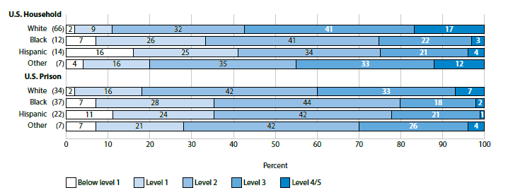
In literacy, the percentages of incarcerated Black (35%) and Hispanic adults (35%) performing at Level 1 and below were not measurably different from the percentages of Black (33%) and Hispanic adults (41%) in the household.
Percentage of adults ages 16-74 at each level of proficiency on the PIAAC literacy scale, by race/ethnicity: 2012 and 2014
Notes:
In the previous slide we looked at the average literacy scores by race. In this slide we are focusing on comparing performance levels by race for both incarcerated and household adults.

Slide 19
In numeracy, the average scores of incarcerated Black and Hispanic adults were significantly different from their household peers’ scores.
*
*
*
*

Slide 20
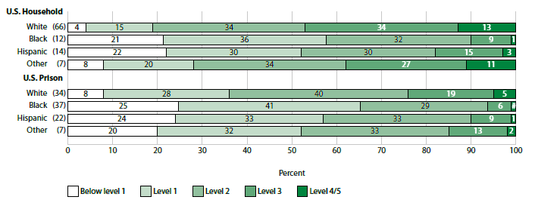
In numeracy, the percentages of incarcerated Black (66%) and Hispanic adults (57%) performing at Level 1 and below were higher than the percentages of Black (57%) and Hispanic adults (52%) in the household.
Percentage of adults ages 16-74 at each level of proficiency on the PIAAC numeracy scale, by race/ethnicity: 2012 and 2014
Notes:
In the previous slide we looked at the average numeracy scores by race. In this slide we are focusing on comparing performance levels by race for both incarcerated and household adults.

Slide 21
For inmates and household adults with less than a high school diploma, average literacy scores were comparable, but average numeracy scores were significantly lower for inmates.
Level 3
Level 2
Level 1

Slide 22
Average literacy and numeracy scores of those in prison for the first time and those previously incarcerated were the same.
Level 3
Level 2
Level 1

Slide 23
Access to Prison Jobs & Skills Use

Slide 24
Sample Background Questions for: Access to jobs and skill use in prison
During your current incarceration...
Do you currently have any prison job?
Are you on a waiting list to start a prison job?
What are/were your most important responsibilities?
How many hours do/did you usually work per week in this job?
In your current job, how often do you usually...
Read (directions, instructions, manuals…)
Write (letters, fill out forms…)
Calculate (prices, costs…)
Do you use a computer in your current job?
How often do you usually use
a word processor, spreadsheets…
To view the entire Prison Background Questionnaire: https://nces.ed.gov/surveys/piaac/questionnaires.asp

Slide 25
Incarcerated adults currently holding a prison job scored higher in literacy than their peers who did not have a prison job.
Level 3
Level 2
Level 1

Slide 26
The majority of inmates reported never using literacy or numeracy skills in their current prison work.

Slide 27
Participation in Education

Slide 28
Sample Background Questions for: Participation in Academic Programs
Are you currently studying for any kind of formal degree or certificate?
During your current period of incarceration, did you take any classes or have a tutor:
to improve your basic reading, writing, and math skills?
to prepare to take the General Educational Development test, or GED?
to prepare to take a high school equivalency program or adult high school program?
How many days, weeks, or months did you attend classes in the past 12 months?
Where did you take the classes?
Why did you participate?
Are you on a waiting list to enroll in an academic class or program of study?
During your current period of incarceration, what is the highest level of education you completed?
To view the entire Prison Background Questionnaire: https://nces.ed.gov/surveys/piaac/questionnaires.asp

Slide 29
Fewer inmates completed some level of education (42%) than no education (58%) during their prison term.
Percentage of incarcerated adults by the highest level of education completed during their current incarceration: 2014
Highest level of education completed | Percentage
Grades 7-9 | 8
High school diploma or GED | 21
Pre-associate education | 4
Certification from college or trade school | 7
Associate's degree | 2
No further education level completed | 58
NOTE: Results for grades 1-6, bachelor's degree, master's degree, professional degree, and doctoral degree are not shown because reporting standards were not met.
42%

Slide 30
Only a small percentage of incarcerated adults were currently studying for a formal degree or credential. However, interest in education programs is high.
21% of incarcerated adults were currently studying for a formal degree or credential
79% percent of incarcerated adults were not currently studying:
70% wanted to enroll in a program, where 25% of them were on a waiting list
30% did not want to enroll in a program

Slide 31
Reasons for wanting to enroll in an academic program

Slide 32
Reasons for not wanting to enroll in an academic program
Notes:
For the 51% of individuals in the “Other” category, their open-ended responses included wanting to devote their time to working on their legal appeals, their imminent release from prison, being already enrolled in some type of class or training, or “not interested.”

Slide 33
Incarcerated adults who wanted to enroll in academic classes or programs of study scored higher on literacy and numeracy.
Level 3
Level 2
Level 1

Slide 34
Participation in Skills Training

Slide 35
Sample Background Questions for: Participation in Job Skills Development Programs
During your current period of incarceration, have you participated in
A job skills or job training program (for example, a computer skills program that teaches Microsoft Word)? What were your reasons for wanting to participate?
Are you on a waiting list?
Have you received any type of IT certification? Did you have to pass a test to get the certification?
Other than IT, have you ever received any type of job-related skill certification?
How long have you spent altogether in any job training course or program?
To view the entire Prison Background Questionnaire: https://nces.ed.gov/surveys/piaac/questionnaires.asp

Slide 36
A small percentage of incarcerated adults participated in a job training program.
23% had participated in a job training program during their current prison term
77% had not participated in a job training program
Of those who had not participated, 14% were on a waiting list

Slide 37
Reasons for not participating in job skills training

Slide 38
Incarcerated adults who participated in job skills or job training programs scored higher in literacy and numeracy than those who did not.
Level 3
*
*
Level 2
Level 1

Slide 39
Summary (1)
Compared with the U.S. household population, the U.S. incarcerated population scored lower in literacy and numeracy.
However, compared to their household peers, no differences were found in literacy for
Black and Hispanic inmates
Inmates with less than a high school credential

Slide 40
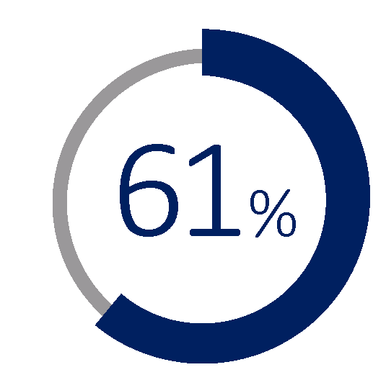
Summary (2) Among incarcerated adults
Compared to those with a prison job, those without a job
had lower literacy scores
-Had a prison job.
-However, many did not use literacy or numeracy skills in that job.
had similar numeracy scores

Slide 41
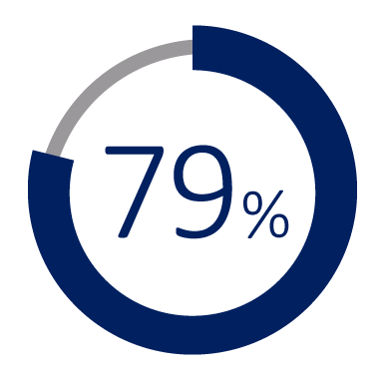
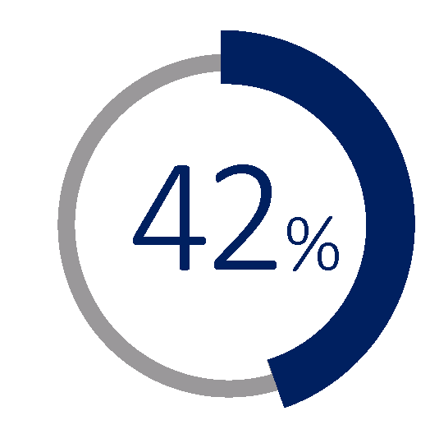
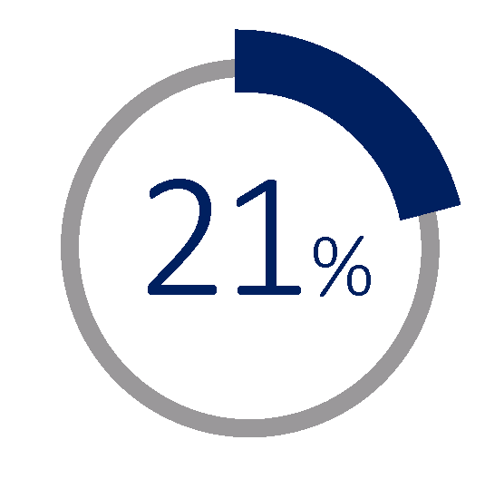
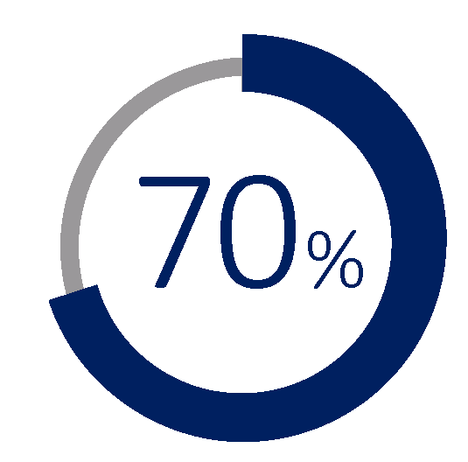
Summary (3) Among incarcerated adults
Interest in education programs is high
completed some level of education during their current prison term.
are currently studying for a formal degree or credential.
Not currently studying, but
of them want to study for a formal degree or credential
Notes:
Note: view slide in “Animation” mode to see the graphic on the far right.

Slide 42
Summary (4) Among incarcerated adults
Education programs are more popular than job training programs.
Completed some level of education during their current prison term
Participated in a job training program
42

Slide 43
Slide Modules you can add to your presentation:
What is PIAAC?
Sample Tasks
More PIAAC Resources

Slide 44
Additional information can be found in the U.S. PIAAC Survey of Incarcerated Adults Results

