Slide 1
Examples of how the U.S. PIAAC Skills Map can be used to inform research and policies

Slide 2
How to Use These Slides
These slides provide additional examples for state and county estimates
Follow the storyline and conclusion of each example by looking at the notes below the slide as well as to find additional information about the example

Slide 3
What is the potential need in Miami-Dade County, FL for educating and training low-skilled workers who have lost their jobs in the service industry due to COVID-19?
To answer this question: Locate the number of adults in Miami-Dade County who are estimated to lose their low-income jobs due to the COVID-19 pandemic, the percentage of adults in the county who are at or below Level 1 in literacy, and the percentage of adults in the county who are unemployed.
Notes:
COVID-19 Job Loss and Need for Workforce Development: Looking at a county with high service sector job loss and a high percentage of adults with low skills
The low-income jobs that Miami-Dade County, FL is projected to lose in the accommodation and food service industry during the COVID-19 pandemic (based on Urban Institute analysis) are likely held by low-skilled workers.

Slide 4
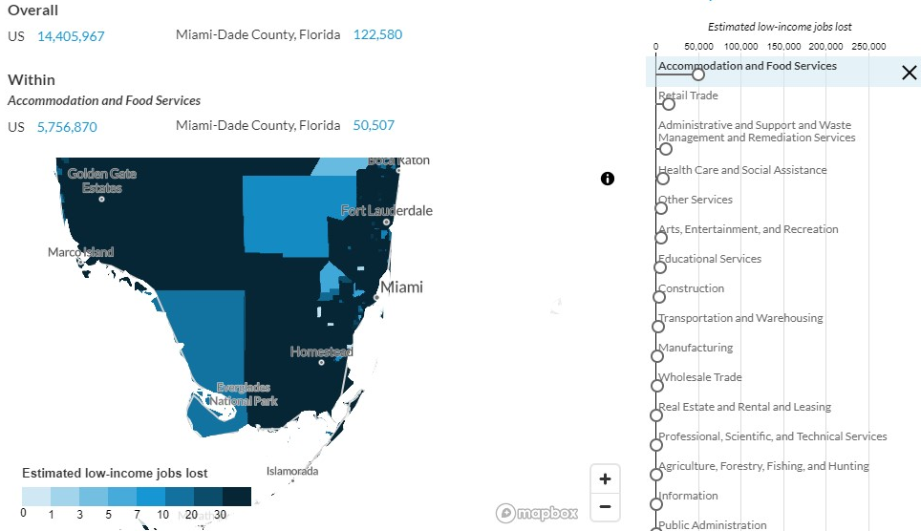
Source: Urban Institute tool (May 2020)
Notes:
According to an Urban Institute analysis, Miami-Dade County, FL is estimated to lose approximately 50,000 jobs within the accommodation and food services industry, one of the more heavily hit low-income industries as a result of the COVID-19 pandemic.
Other background info: according to the PIAAC Skills Map: More than two-thirds (67%) of Miami-Dade County adults (ages 16-74) were employed prior to the pandemic and 21% worked in a service occupation.

Slide 5
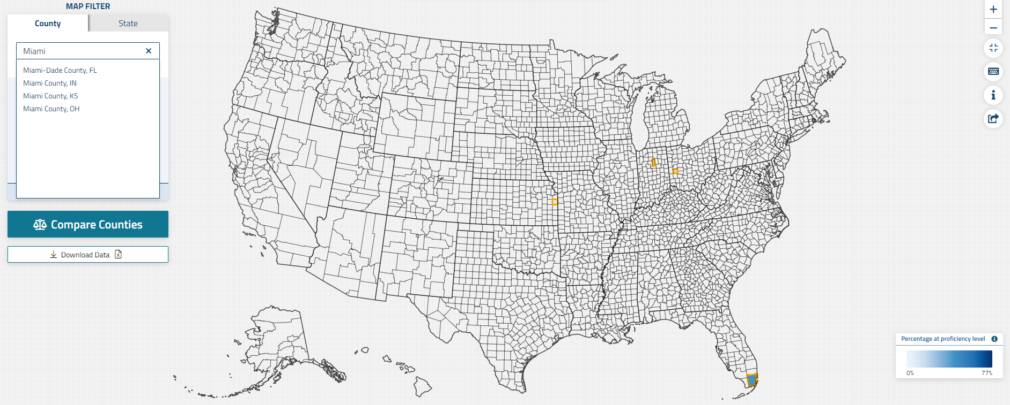

Slide 6
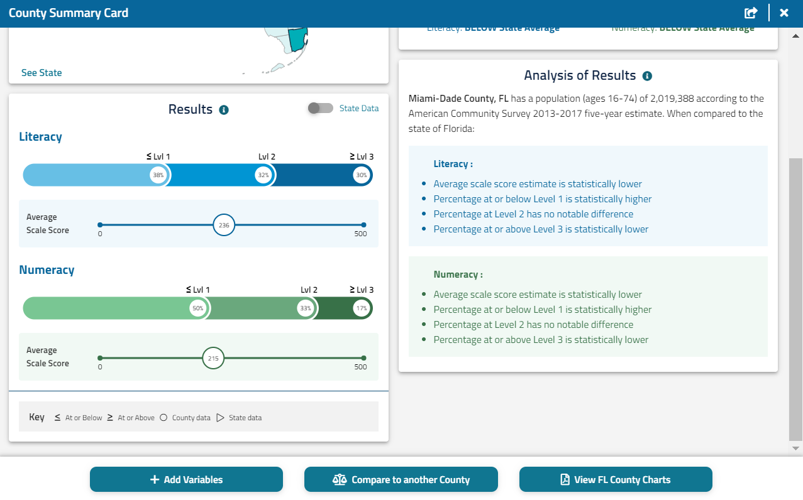
Notes:
To examine the percentage of adults that are employed, and the percentage of adults working in the service occupation for Miami-Dade county, select “Add Variables.”

Slide 7
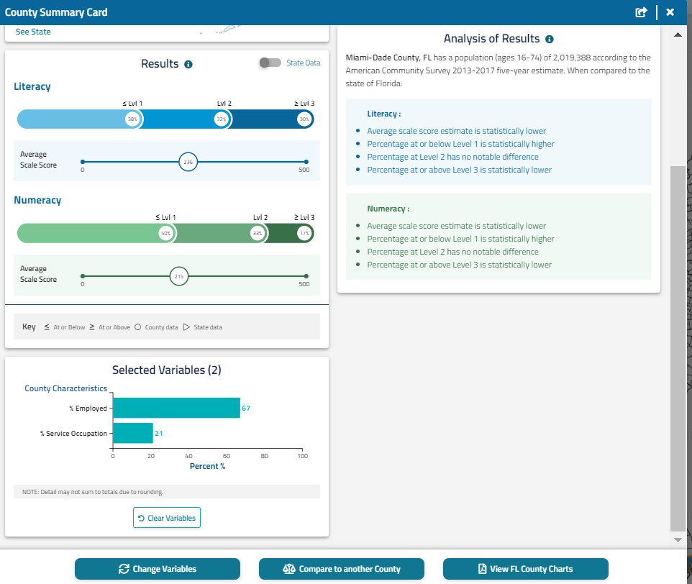
Notes:
From the results section, it is apparent that the percentage of adults at or below level one in literacy (38%) and numeracy (50%) are quite high compared to the state of Florida (24%) and (35%). The “selected variables” section shows that 67% of adults in this county are employed, and 21% are working in the service industry.

Slide 8
Results
Miami-Dade County, FL would be a sensible place for adult education providers to target for re-training of low-skilled adults because there is a higher percentage of low-skilled adults (those who performed at or below Level 1 in literacy) in this county (38%) compared to the state of Florida (24%).
Miami-Dade County was heavily impacted by job loss in the service industry which is an industry where adults with low literacy skills held jobs.
By providing education and training to these low-skilled adults, it will help them regain employment as businesses recover from the COVID-19 pandemic.

Slide 9
Should the funding/programming target Brooks or the neighboring Kenedy County, both in the bottom 10 list of low performing counties in the U.S.?
To answer this question: Locate two low-performing counties (Brooks County and Kenedy County) and compare percentage of adults in the counties who are at or below Level 1 in literacy.
Notes:
To locate the low performing counties on the Skills Map, look for the darker shaded counties.

Slide 10
Lowest-Performing Counties
Bottom 10 (combined)
Brooks County, TX
Culberson County, TX
Dimmit County, TX²
East Carroll Parish, LA¹
Hudspeth County, TX
Jefferson County, MS¹
Kenedy County, TX
Maverick County, TX²
Presidio County, TX²
Starr County, TX
Willacy County, TX
Zapata County, TX
Zavala County, TX
(Bottom 10 Counties by Average Literacy and Numeracy Scores)
¹ Bottom 10 in numeracy only NOTE: Counties are listed in alphabetical order.
² Bottom 10 in literacy only Brooks County and Dimmit County have the same score for literacy.
Notes:
This is an analysis of 10 bottom performing counties in the United States. Both Brooks and Kenedy County are on the list. The local authorities would like to determine how to fund adult education programs in these two counties.

Slide 11
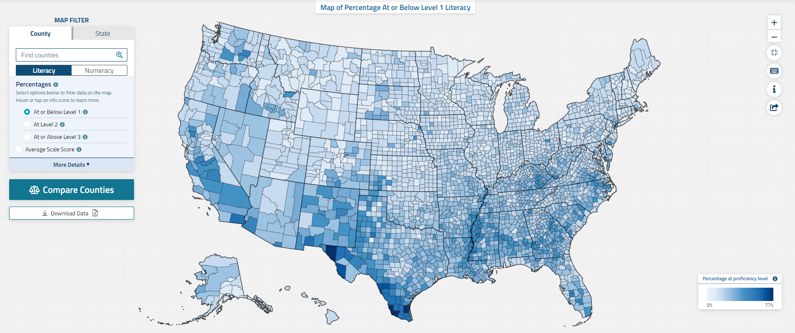
Notes:
The Skills Map makes it very easy to compare between counties or states. Just click "Compare Counties" and look up Brooks and Kenedy county. The local authorities would like to compare the percent of the population at or below level 1, because that is the population that the funding will target.

Slide 12
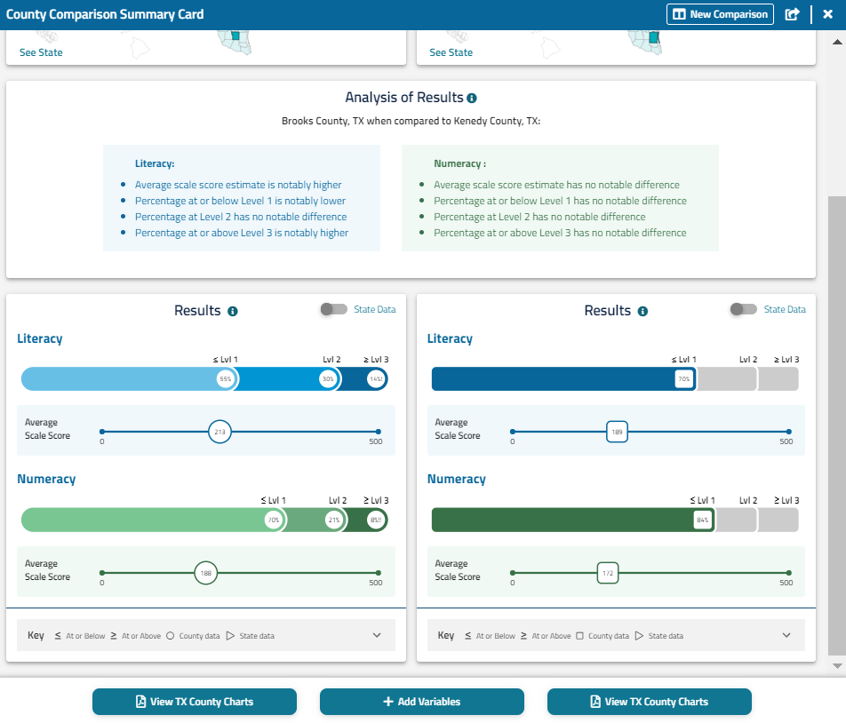
Notes:
You will get a comparison summary card. It even does some of the analysis for you—looking at this box at the top, you can see that Brooks County has a higher average score for literacy, as well as a lower percentage of adults at the lowest levels of literacy proficiency and a higher percentage at the highest levels. For numeracy, they're comparable. However, both of these counties have significantly higher percentages of adults at or below level one compared to the state of Texas (28% for literacy, and 39% for numeracy).

Slide 13
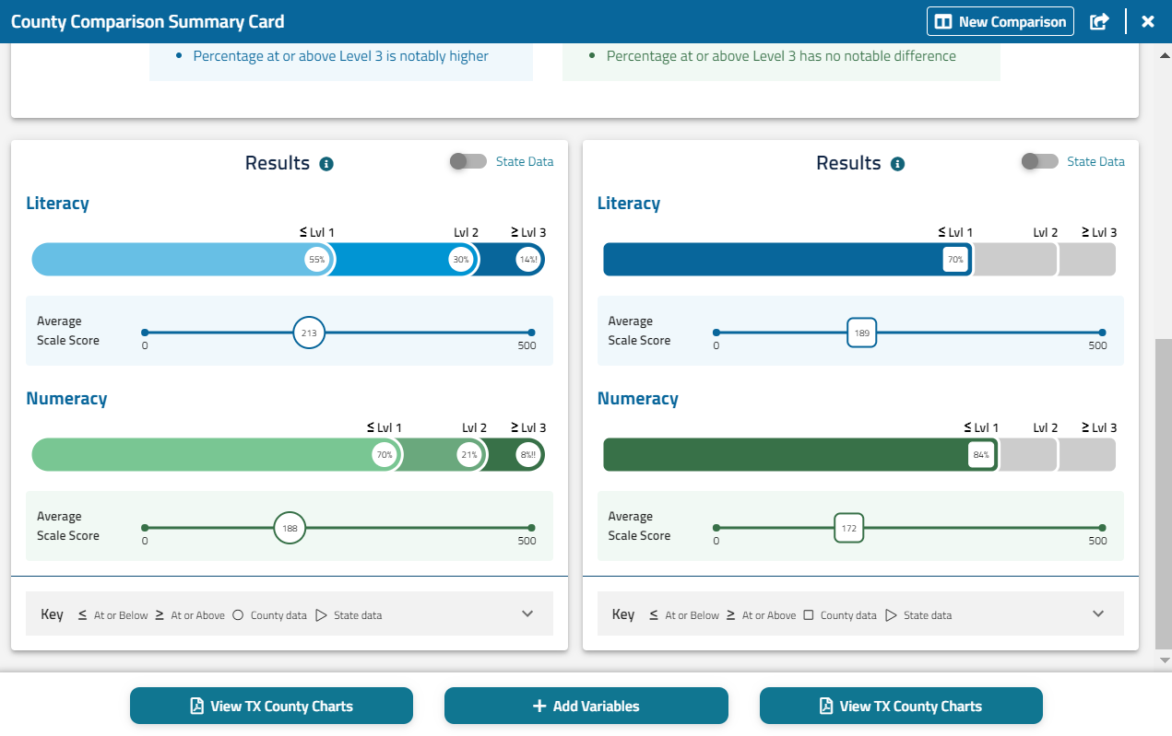
Notes:
You can also look at how the demographics compare to further inform the decision. At the bottom of the summary card you can go in and select variables to compare.

Slide 14
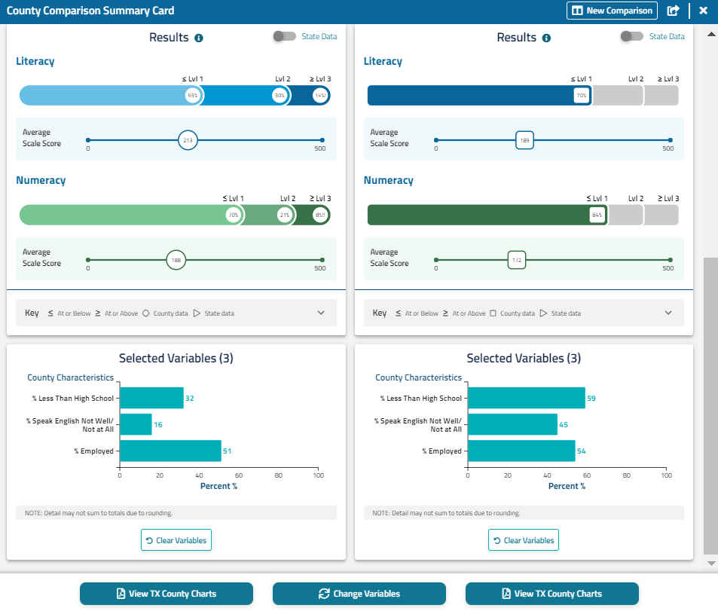
Notes:
For Brooks County, there is 32% of adults who had less than a high school education, 16% of adults in the county who do not speak English well/not at all, and 51% of adults in the county are employed. For Kenedy County, 59% of adults have less than a high school education, 45% do not speak English well/not at all, and 54% of adults are employed.

Slide 15
Results
Kenedy County has more need than Brooks County for educational funding/programming because there is a higher percentage of low-skilled adults (those who performed at or below Level 1 in literacy) in Kenedy County (70%) compared to Brooks County (55%).
The information on educational attainment and English language skills help to further inform the educational funding/programming decision. 59% of Kenedy County adults have less than a high school education, and 45% of Kenedy County adults speak English not well/not at all.
Notes:
This data could also be used to conduct a similar analysis as was done in the main PowerPoint example with California to get an estimate of the total number of people that might benefit from education and training in each county.

Slide 16
What literacy level is appropriate for public health materials about preventing the spread of COVID-19 in different counties in Kansas?
To answer this question: Locate the percentage of adults in Ford and Kiowa Counties in Kansas who are low-skilled (at or below Level 1 in literacy) and use the available materials appropriate to the level of skills of adults in these counties.

Slide 17
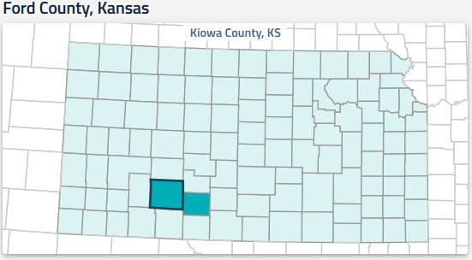
Notes:
Two neighboring counties, Ford and Kiowa, are discussing how to communicate information to their residents about stopping the spread of COVID-19. In order to choose from several types of flyers to be posted in parks and other public places, the local officials can use the PIAAC Skills Map to learn about the literacy proficiency of their adult population and ensure that public materials are accessible for the majority of residents.

Slide 18
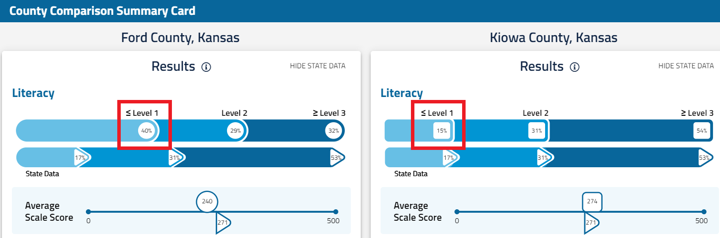
Notes:
According to the PIAAC Skills Map tool, 40% of Ford County adults have low literacy skills (performing At or Below Level 1), compared to only 15% of Kiowa County adults. On the flip side, 60% of Ford county adults have medium to high literacy skills (performing at or about Level 2) and 85% of adults in Kiowa County have medium to high literacy skills.

Slide 19
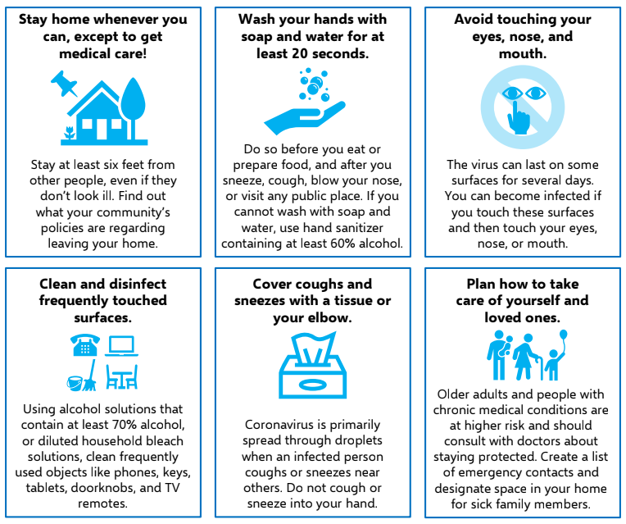
Preventing the Spread of COVID-19
Medium to High Literacy Level
Ford County
40% low-skilled
60% medium to high-skilled
Kiowa County
15% low-skilled
85% medium to high-skilled
Some icons are ambiguous or confusing.
Source: Georgia State University collection of coronavirus resources. COVID-19 Protection
Notes:
Several types of flyers are presented. Ford county officials express concern about distributing this flyer in their county, since it presents information at a medium literacy level. [click] For example, instead of the icons helping to convey the text, the text needs to be read to understand the icons – what does, for example, a pin on the house mean? Or the telephone, computer, table and chairs and mop with a bucket mean?

Slide 20
Preventing the Spread of COVID-19
Medium to High Literacy Level
Ford County
40% low-skilled
60% medium to high-skilled
Kiowa County
15% low-skilled
85% medium to high-skilled
60% alcohol or 70% alcohol?
Directions are too detailed
and contain competing information.
Source: Georgia State University collection of coronavirus resources. COVID-19 Protection
Notes:
The text is dense in information [click]: a lot of text in the titles and even more in the description. There is also competing information. [click] In one place, the text says to use a solution with “at least 60% alcohol” and in another place it says to use a solution with “at least 70% alcohol.” Adults with low literacy proficiency may struggle to understand what they should be doing to prevent the spread of COVID-19. County officials of Ford County, with 40% of the population who are low skilled, have concerns about distributing this flyer.

Slide 21
Preventing the Spread of COVID-19
Medium to High Literacy Level
Ford County
40% low-skilled
60% medium to high-skilled
Kiowa County
15% low-skilled
85% medium to high-skilled
Directions explain in
detail what to do in which situations
Source: Georgia State University collection of coronavirus resources. COVID-19 Protection
Notes:
The county officials of Kiowa County, with only 15% of low skilled and 85% of their population being medium to high skilled, could be less concerned about conveying information through text. [click] 85% of their population are at a level where they are likely to be able to read print and digital texts, relate multiple pieces of information within or across a document, compare and contrast, and draw simple inferences.

Slide 22
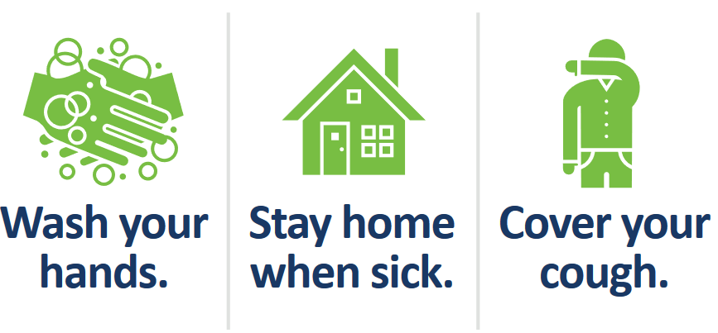
Preventing the Spread of COVID-19
Low Literacy Level
Ford County
40% low-skilled
60% medium to high-skilled
Simple directives
Clearer presentation of
what needs to be done
Source: Georgia State University collection of coronavirus resources. COVID-19 Protection
Notes:
Ford county officials find this flyer more appropriate to the 40% of the population in their county that are at the lowest levels of literacy. This flyer presents information in the way that adults at low levels of literacy are likely to understand - short texts, basic vocabulary, and a request to perform simple tasks.

Slide 23
Results
Ford county’s officials may find the simpler flyer more appropriate, since this flyer presents information in the way that adults at low levels of literacy (40% in Ford) are likely to understand - short texts, basic vocabulary, and a request to perform simple tasks.
Kiowa county’s officials may opt for a flyer that contains directions that would correspond to the mid- to high level of proficiency in literacy (85% of adults in Kiowa).

Slide 24
Where should a high-tech company based in Manchester, New Hampshire consider building a new branch in the state?
To answer this question: Locate the percentage of adults in Hillsborough county (home of Manchester) who are at or above Level 3 in numeracy and find counties that have a similar percentage at this level.
Notes:
Let’s say it’s a high-tech company in Manchester, New Hampshire. They need to ensure a higher skilled workforce is available in the county where they decide to build a new branch, which is at about Level 3 or above in PIAAC. They are especially interested in the numeracy skill of the workforce.

Slide 25
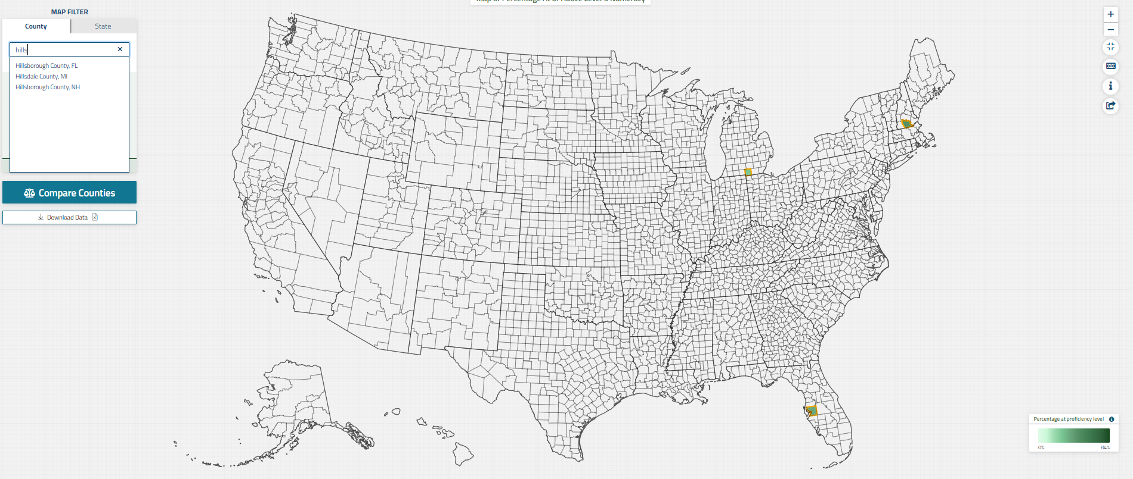
Notes:
The city of Manchester is located in Hillsborough County in New Hampshire. Let’s look up the Hillsborough County on the map of numeracy choosing tab of the Counties.

Slide 26
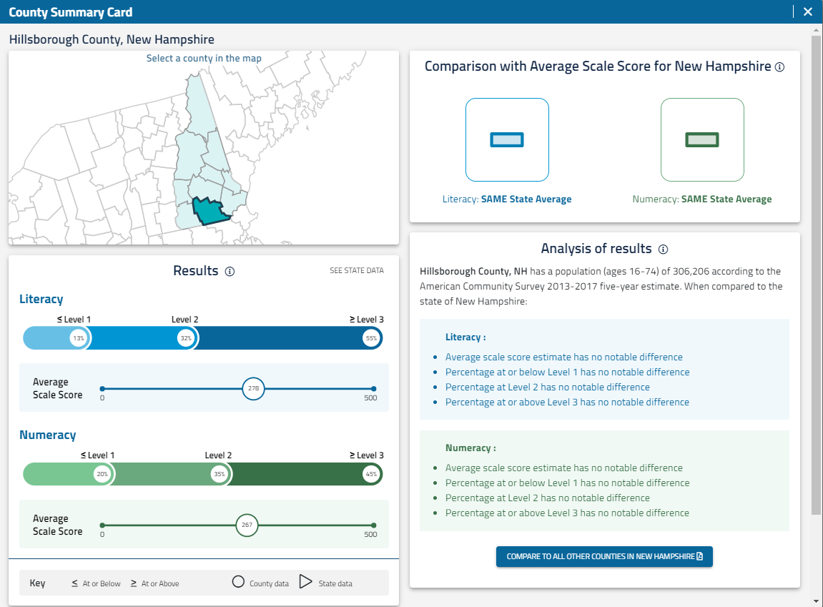
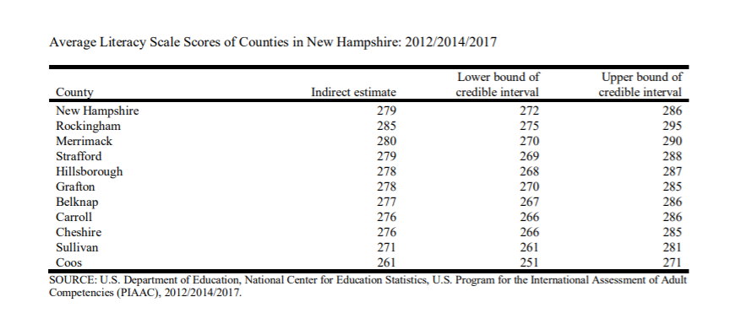
Notes:
When we call up the State Summary Card, at the bottom right hand side, we can press a button that lets us see and compare all the counties in the state of New Hampshire.

Slide 27
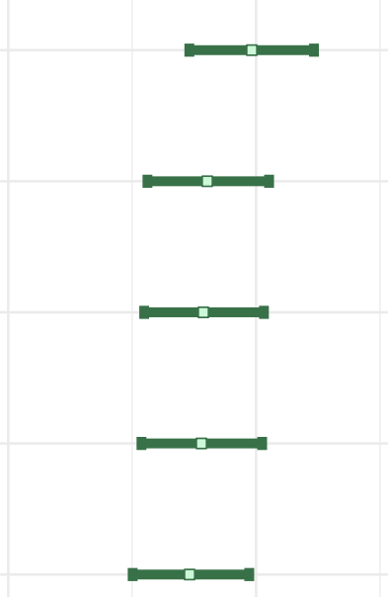
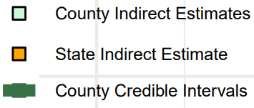
Percentage of Adults With Numeracy Skills at or Above Level 3
Rockingham
County Indirect Estimate
Credible Interval
Merrimack
Hillsborough
(home of Manchester)
Strafford
Grafton
Notes:
A pdf display opens up with the estimates for both literacy and numeracy for each of the proficiency measures and their confidence intervals. We find the page that compares the counties on the percentages of numeracy skills at or above Level 3. And see that Hillsborough county, home county of Manchester, has similar percentages of adults in this measure to three of the counties: Rockingham, Merrimack and Strafford. Let’s explore the two counties that may have higher percentages of adults at or above Level 3 – Rockingham and Merrimack.

Slide 28
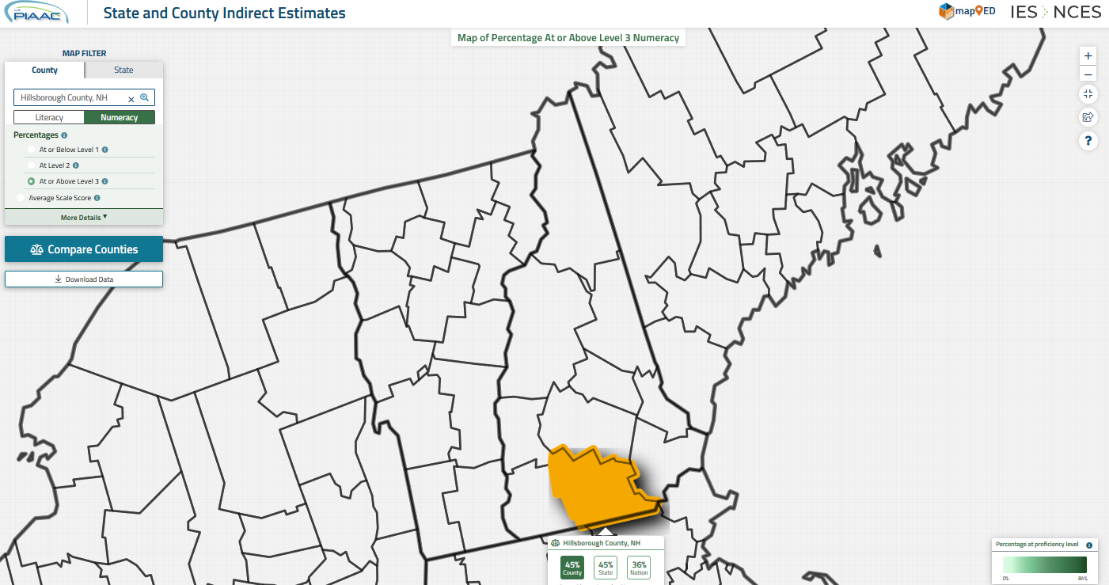
Notes:
This screenshot is a zoomed-in version of the U.S. PIAAC Skills Map showing at or above level 3 for Hillsborough County, NH in numeracy. This is a step before the comparison of Hillsborough and Rockingham counties.

Slide 29
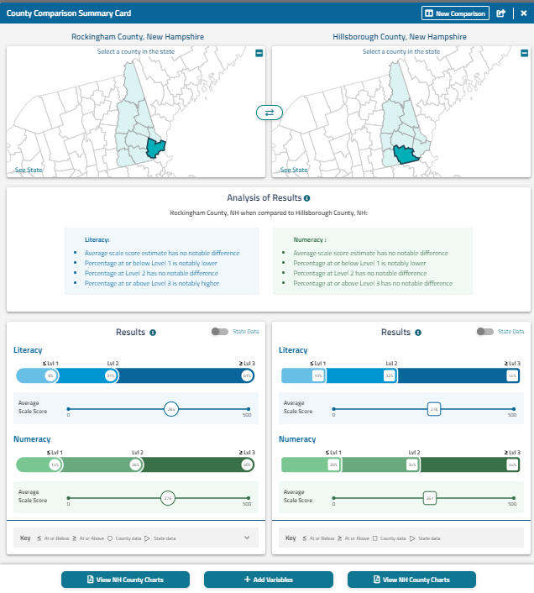
Notes:
Compared to Hillsborough County, Rockingham County has a notably lower percentage of adults at or below level one in numeracy, there is no notable difference in percentage of adults at level two for numeracy, and for the desired statistic (adults at or above level 3) there is no notable difference for numeracy.

Slide 30
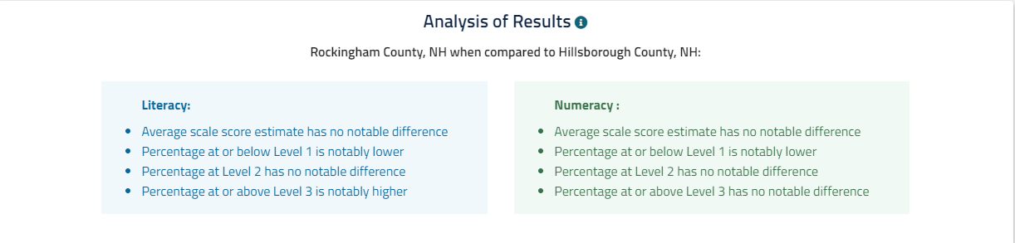

Slide 31
Results
Given that Rockingham County has similar percentage of adults at or above Level 3 in numeracy as Hillsborough County (home of Manchester), 36% in Rockingham and 35% in Hillsborough, Rockingham County may be a good location for the new branch of the high-tech company.

Slide 32
Parents in which counties in Nebraska are likely to have more difficulties to support their children’s remote learning?
To answer this question: Locate lower-performing counties in Nebraska using the map (Dakota County and Colfax County). Select one of the counties (Dakota County) and locate the percentage of adults at or below Level 1 in literacy and numeracy.
Notes:
A factor in potential learning-loss from school closures and the transition to remote learning due to COVID-19 that is not discussed as often is whether parents have the necessary skills to support their child’s learning

Slide 33
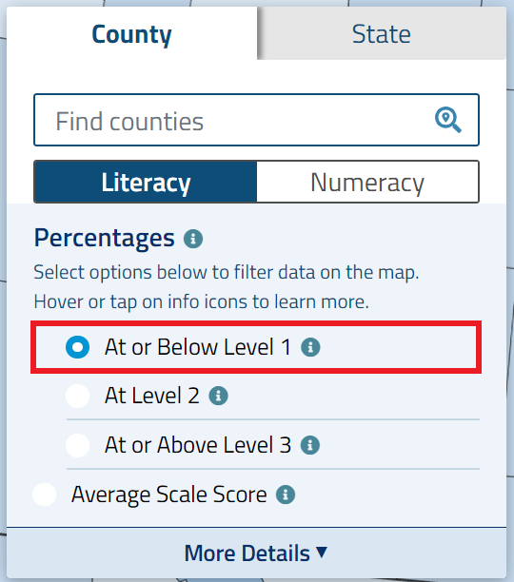
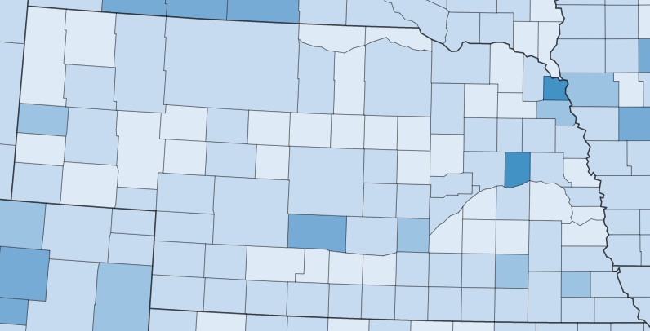
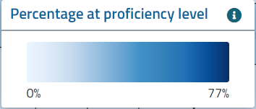
Dakota County
Colfax County
Notes:
To decide where to concentrate their efforts, policymakers and stakeholders can use the Skills Map to find which counties have high percentages of low-skilled adults, performing At or Below Level 1 in literacy or numeracy.
Darker shades indicate higher percentages in the Skills Map, so Dakota County and Colfax County appear to have the highest percentages of adults with low literacy skills among Nebraska counties.

Slide 34
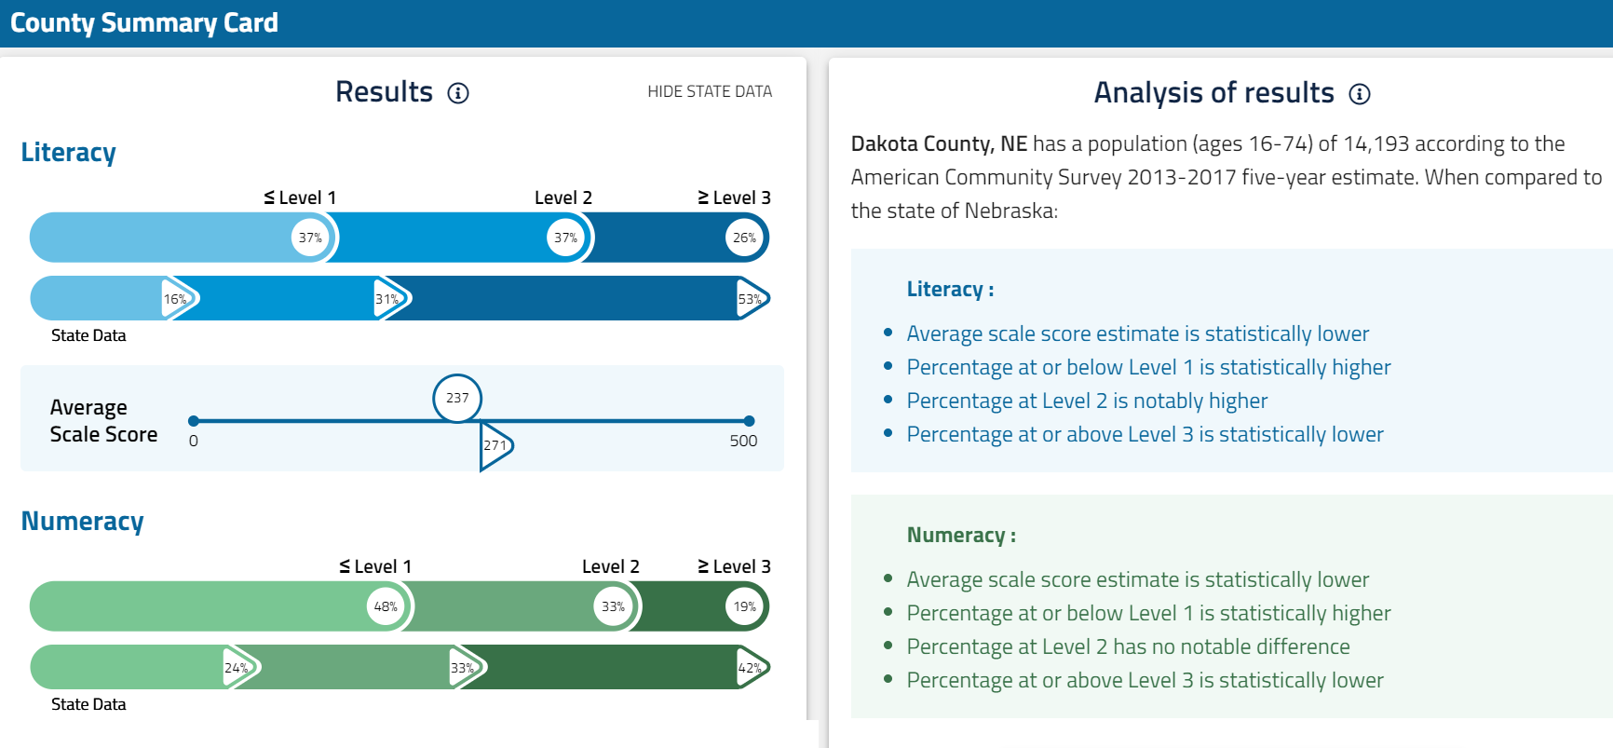
Notes:
In Dakota County, Nebraska, 37% of adults have low literacy proficiency (performing At or Below Level 1). This percentage is significantly higher than the percentage for Nebraska adults overall (16%).
In addition, 48% of adults have low numeracy proficiency (performing At or Below Level 1), which is also significantly higher than the percentage for Nebraska adults overall (24%).
Parents of K-12 students in Dakota County, compared to others in Nebraska, are likely to have more difficulty supporting or directing their children’s education and would benefit from increased educational resources, such as more guidance and materials from schools or better access to online learning platforms.

Slide 35
Results
Parents of K-12 students in Dakota County are likely to have more difficulty supporting or directing their children’s education, as there is a higher percentage of low-skilled adults (those who performed at or below Level 1 in literacy) in this county (37%) compared to the state of Nebraska (16%).
Additionally, 48% of Dakota County adults have low numeracy proficiency (at or below Level 1), which is also significantly higher than the percentage for Nebraska adults overall (24%)
Parents in Dakota County would benefit from increased educational resources, such as more guidance and materials from schools or better access to online learning platforms.

Slide 36
Should a community college based in Bronx, NY consider opening a satellite campus in Queens, NY?
To answer this question: Compare the two counties on the percentage of adults with middle-skill-level, at Level 2, in literacy and numeracy.
Notes:
Our question here is where in New York City will a good location for a community college satellite campus be.

Slide 37
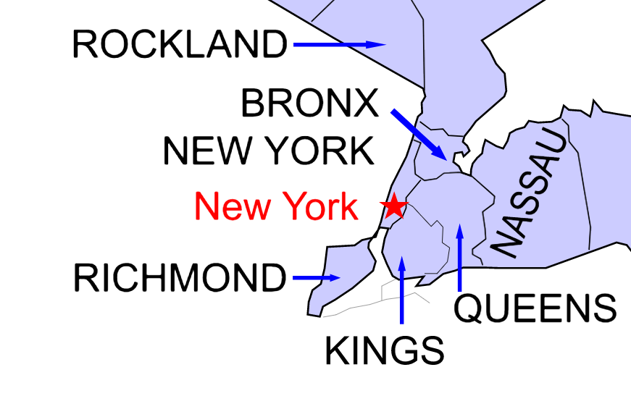
(Manhattan)
(Staten Island)
(Brooklyn)
Notes:
Located in Bronx, NY, the community college is considering opening a satellite campus in Queens NY, with target entrant population of adults with middle-skill-level, at about Level 2 of PIAAC.

Slide 38
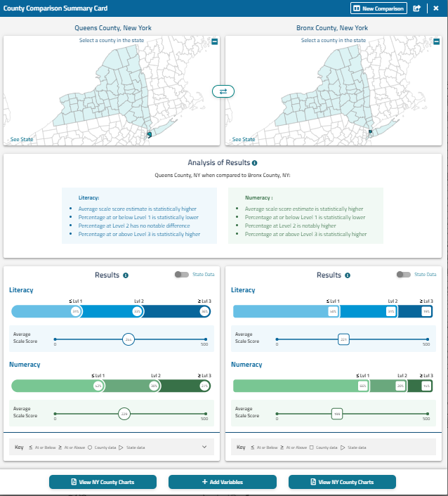
Notes:
When we have the County comparison card, we can see the results for the two county comparisons.

Slide 39
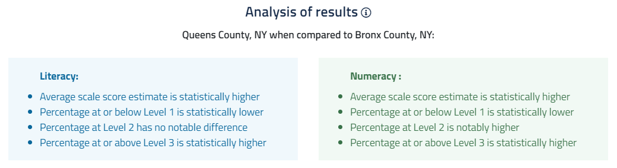
Notes:
Comparing the two counties, we see that in literacy, Queens is no different from Bronx, but in numeracy Queens has a higher percentage of adults at Level 2 than does Bronx.

Slide 40
Results
Depending on the programs offered, Queens would be a good place to open the Bronx’s community college’s new satellite campus in, because adults living in Queens have similar literacy and higher numeracy skills than adults living in the Bronx.

Slide 41
What is the potential for retraining skilled workers in King County, WA who lost service industry jobs due to the COVID-19 pandemic?
To answer this question: Locate the number of adults in King County who are estimated to lose their low-income jobs and the percentage of adults in the county who are at or above Level 3 in literacy and numeracy.
Notes:
Upskilling/Skills Mapping: Looking at a county with high service sector job loss and a high percentage of adults with high skills to understand the potential for retraining
Example: A company wants to build a campus in an area with a large number of highly skilled workers who can be re-trained for work in the health care sector. The company managers know many service sector workers have recently been laid off due the COVID-19 pandemic and is hoping to bring some of those highly skilled workers to the company. Would King County, WA be a good candidate to build the campus?

Slide 42
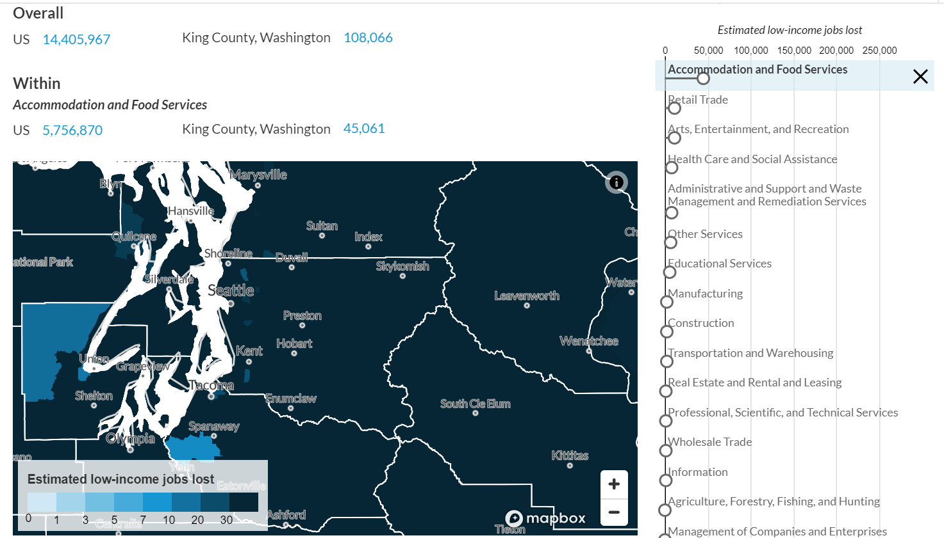
Source: Urban Institute tool (May 2020)
Notes:
According to an Urban Institute analysis, King County, WA is estimated to lose approximately 45,000 jobs within the accommodation and food services industry as a result of the COVID-19 pandemic.
According to PIAAC Skills Map: Around three-quarters (74%) of King County, WA adults (ages 16-74) were employed prior to the pandemic and 15% worked in a service occupation.

Slide 43
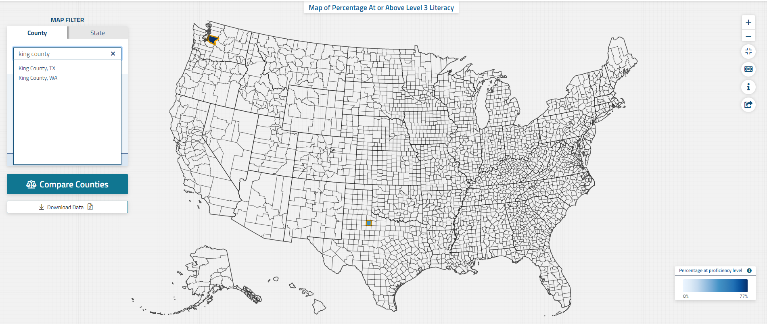

Slide 44
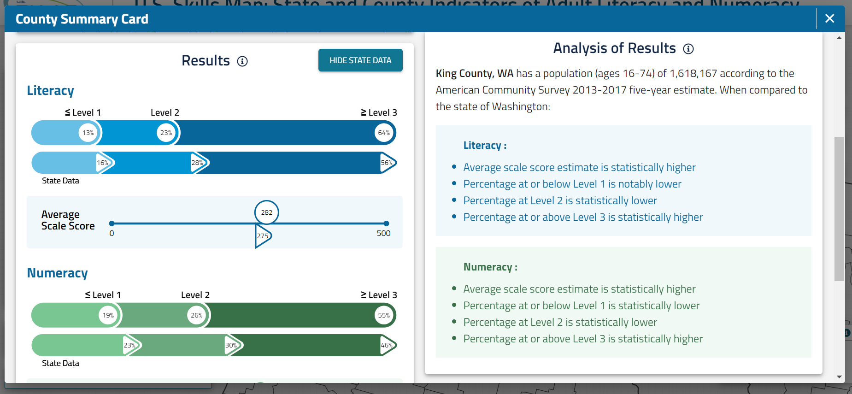
Notes:
64% of adults in King County have literacy skills at the highest levels (Level 3 or above) and 55% of adults have numeracy skills at the highest levels (Level 3 or above), with the percentage of adults with high skills being above the state average in both literacy and numeracy. So King County, WA would have great potential for re-training highly-skilled workers.

Slide 45
Results
King County, WA would have great potential for re-training highly-skilled workers as the percentage of adults with high skills (those who performed at or above Level 3) in this county (64% in literacy and 55% in numeracy) above the state average (56% in literacy and 46% in numeracy).
King County had a substantial number of jobs lost within the accommodation and food services industry as a result of the COVID-19 pandemic.
Highly-skilled adults who may have lost their jobs can be retrained for work in other industries, such as the health care sector.

