Slide 1
U.S. Low-Skilled Workers:
Focus on Numeracy Skills

Slide 2
Guidelines for building your presentation:
Add this slide module to the following slide modules to create the full PIAAC story:
  What is PIAAC
  Overview of Results (slides 1-11)
You can also add:
  selections from Sample PIAAC Tasks
  Gateway & Other Resources
  Education and Skills Online
  selection from State of the U.S. Workforce: Focus on Literacy Skills

Slide 3
Skill level of U.S. adults

Slide 4
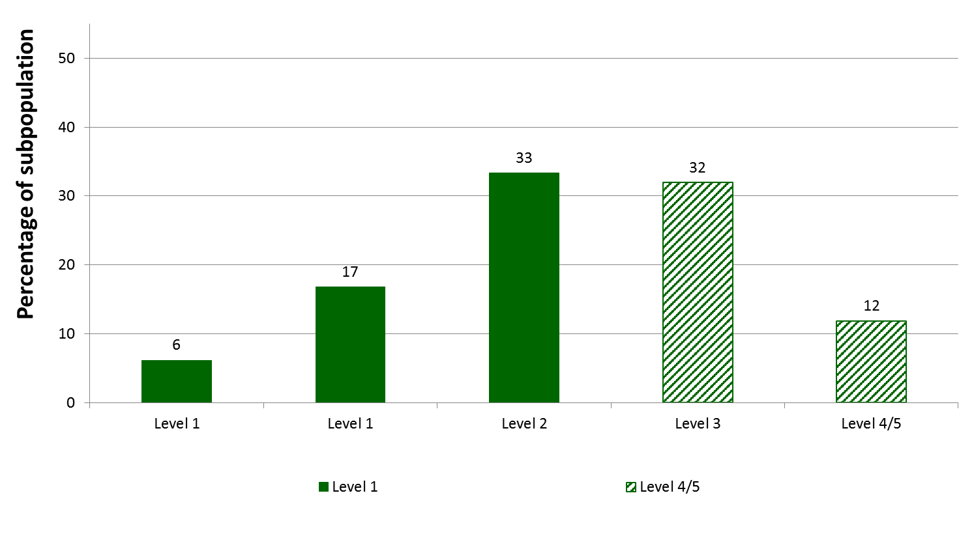
56% of U.S. working adults scored no higher than level 2 in numeracy; 23% scored at the two lowest levels.
Note: Detail may not sum to totals because of rounding.
Notes:
No T-Tests were necessary.

Slide 5
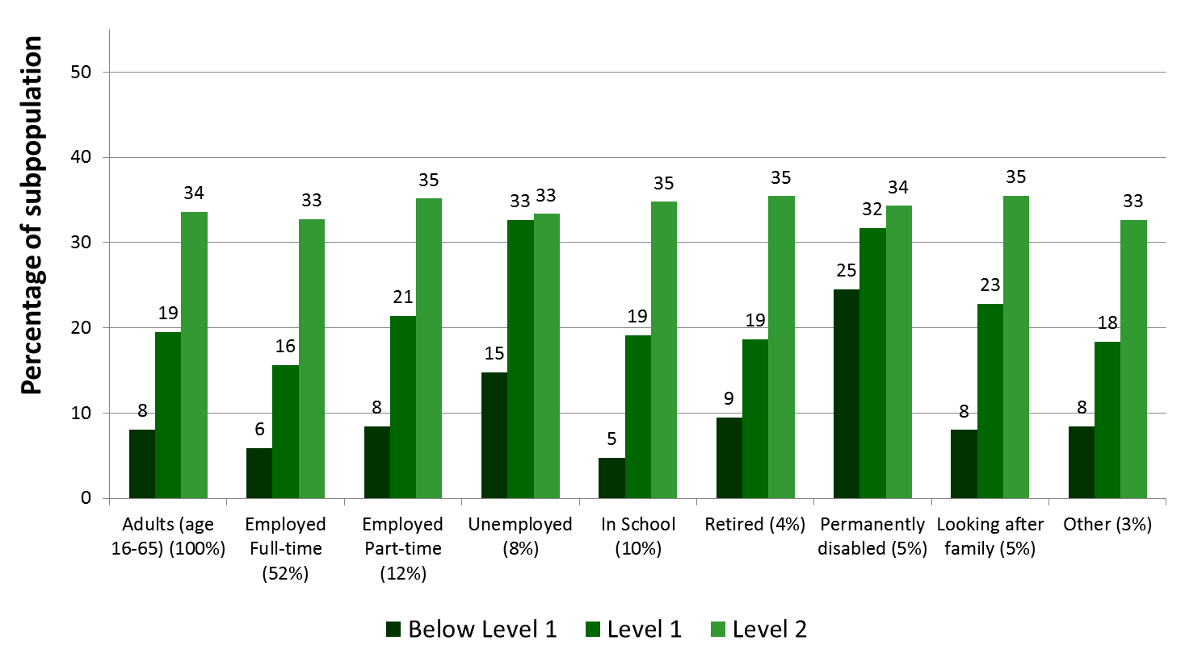
Compared to full-time workers, the percentage with low skills in numeracy is greater for part-time workers and the unemployed.
Note: Not all numeracy levels or employment categories are shown.
The numbers in the parenthesis show the percentage distribution of the characteristic within the population.
Notes:
T-test: Compared full time vs. unemployed and part time vs. unemployed

Slide 6
Why does the skill level of our workforce matter?

Slide 7
Since 1970, there has been a shift in the U.S. economy away from routine and manual tasks and toward more analytic and interpersonal tasks in occupations.
Mean task input in percentiles of 1960 distribution
Source: Autor, D. H. and B.M. Price (2013), "The Changing Task Composition of the US Labor Market: An Update of Autor, Levy, and Murnane (2003)", MIT Mimeograph, June.

Slide 8
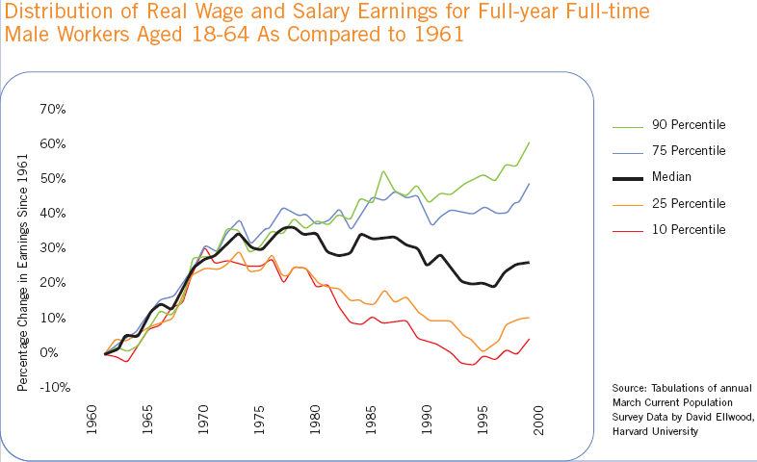
The percentage change in earnings since the 1970s mirrors the change in occupations.
Percentage Change in Earnings Since 1961
Tabulations of annual March Current Population Survey Data, by David Ellwood, Harvard University.
Tabulations of annual March Current Population Data, by David Ellwood, Harvard University. Slide prepared by ETS.

Slide 9
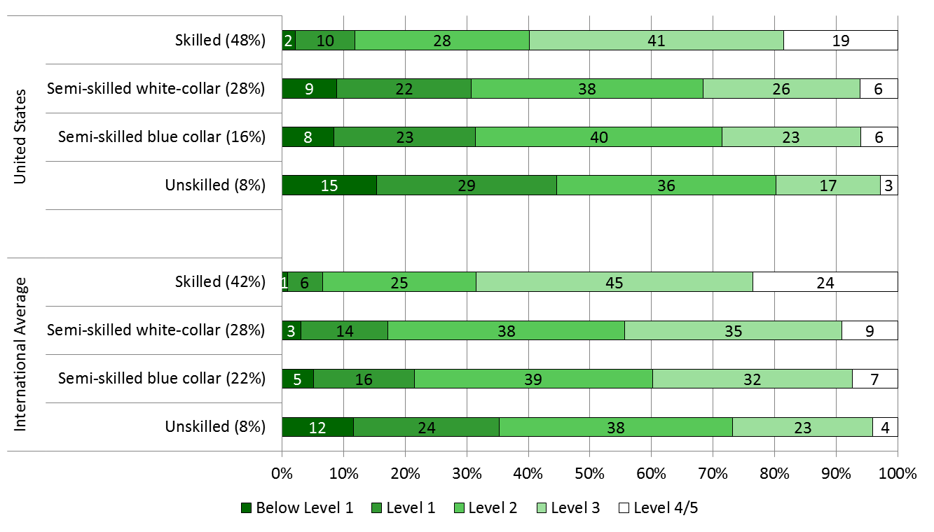
There were significantly higher percentages of low-skilled U.S. workers in numeracy across all occupation types in comparison to their international peers.
NOTE: The numbers in the parenthesis show the percentage distribution of the characteristic within the population.
Notes:
T-test: Compared U.S. vs International

Slide 10
Where are low-skilled adults in the U.S. working?

Slide 11
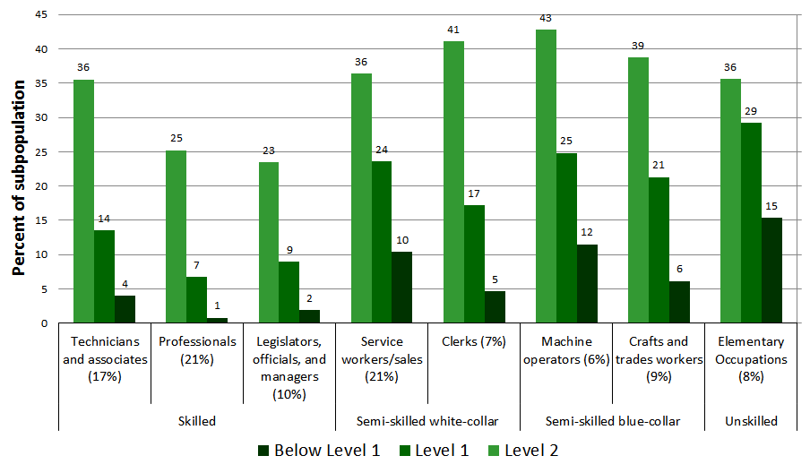
Compared to workers in skilled occupations, a higher percentage of workers in elementary and semi-skilled occupations have low numeracy skills.
NOTE: The numbers in the parenthesis show the percentage distribution of the characteristic within the population.
Notes:
Ranked by total percentage in Level 2 + Level 1 + BL1 within unskilled, semi-skilled blue-collar, semi-skilled white-collar, and skilled

Slide 12
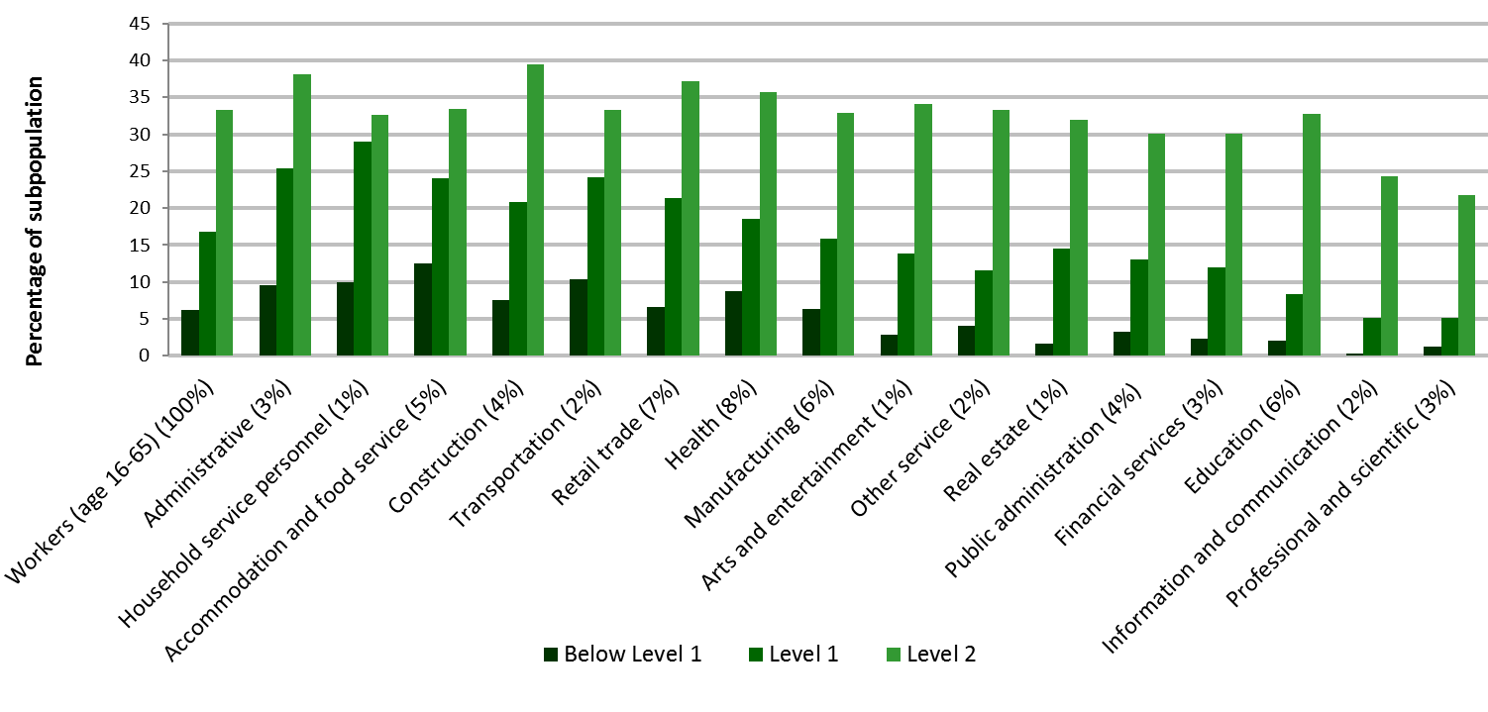
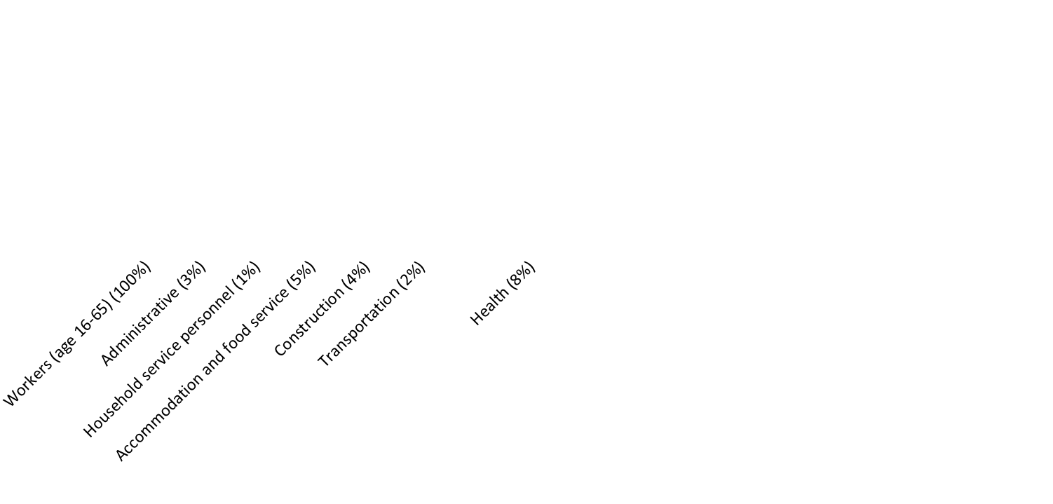
Compared to all workers (age 16-65), higher percentages of workers in the construction, administrative, transportation, accommodation and food service, household service, retail trade, and health industries were low-skilled in numeracy.
NOTE: The numbers in the parenthesis show the percentage distribution of the characteristic within the population.
Notes:
Ranked by total percentage in Level 2 + Level 1 + BL1

Slide 13
How do the skills of U.S. workers differ by gender, age, nativity, and race/ethnicity?

Slide 14
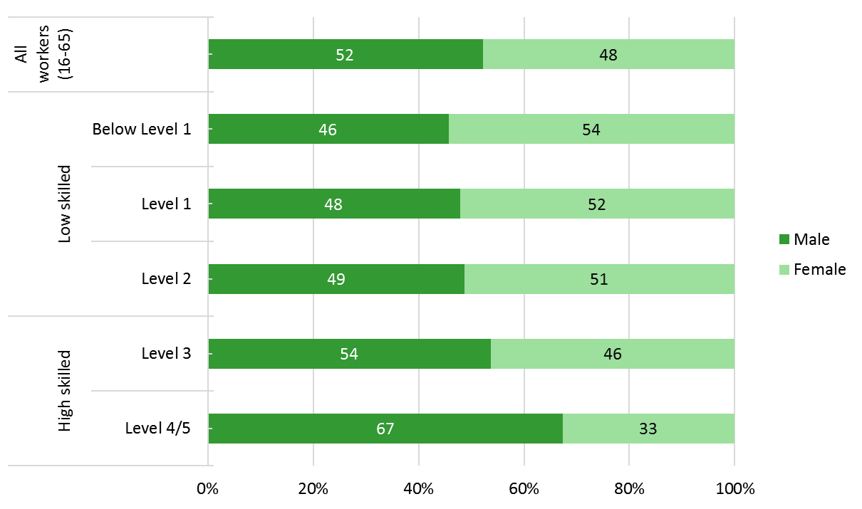
Compared to all workers, there was a significantly higher percentage of females among U.S. workers who are low-skilled in numeracy.
Notes:
T-tests were done comparing the percentage of males in the low-skilled population (combined Below Level 1, Level 1, Level 2) and the percentage of females in the low skilled population (combined Below Level 1, Level 1, Level 2).

Slide 15
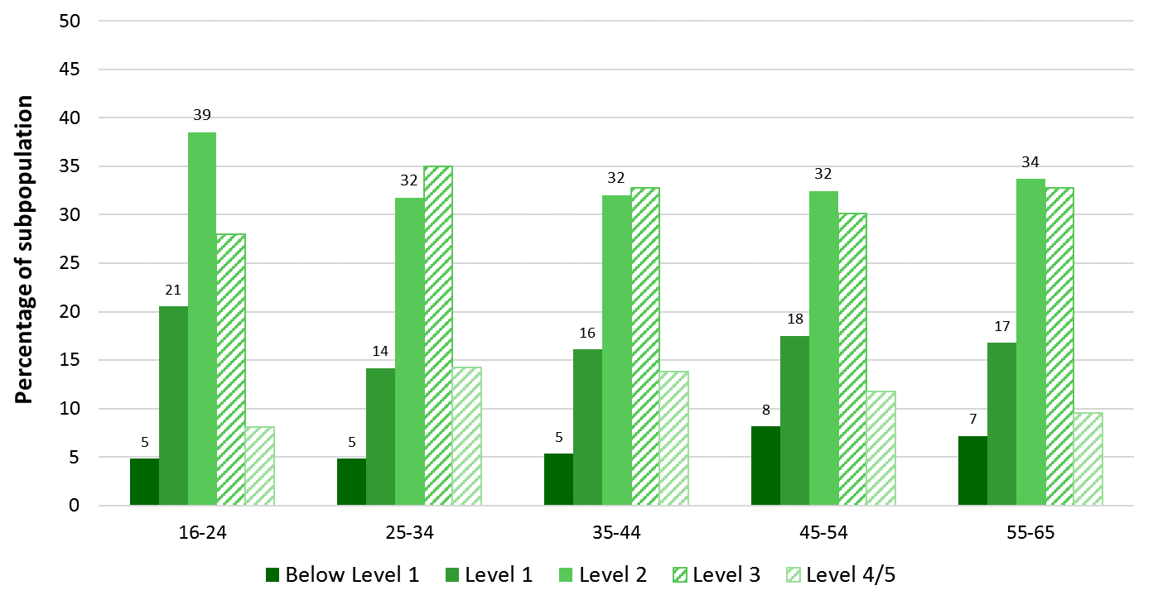

The percentage of adults ages 16-24 with low numeracy skills is not significantly different from the percentages of adults ages 45-54 and 55-65.
Notes:
T-test were done on combined Below Level 1, Level 1, and Level 2 estimates for workers ages 25-34 vs. workers 16-24; workers ages 25-34 vs. workers 35-44; workers ages 25-34 vs. workers 45-54;p and workers ages 25-34 vs. workers 55-65.

Slide 16
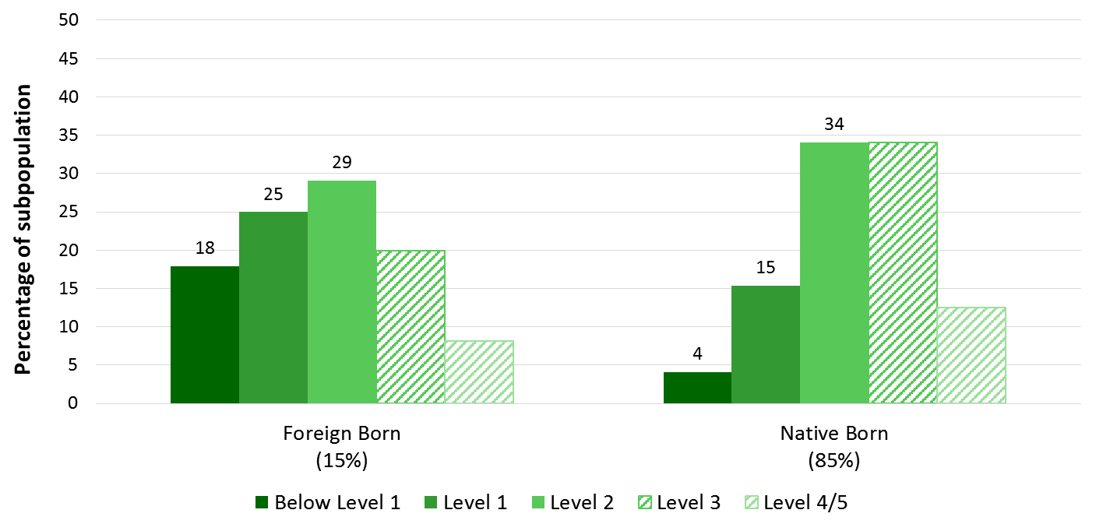

Compared to native-born, a greater percentage of foreign-born U.S. workers are low-skilled in numeracy.
Notes:
T-test was done comparing the percentage foreign born in the total working population vs. the percentage foreign born in the low-skilled population (combined Below Level 1, Level 1, Level 2).

Slide 17
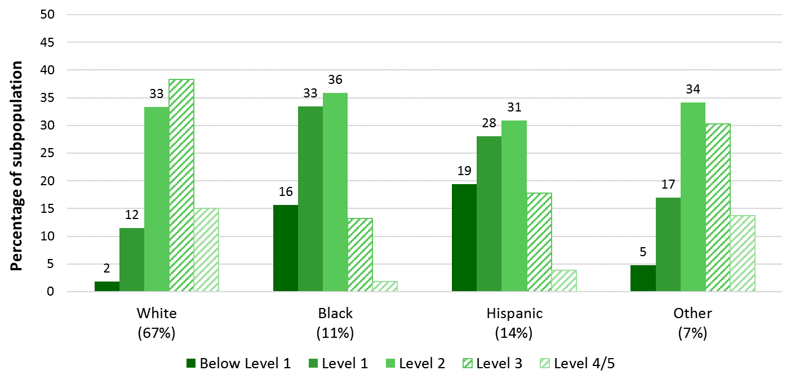
Among U.S. workers, those who are Hispanic, Black and Other race are more likely to be low-skilled in numeracy than those who are White.
Notes:
T-test were done on combined Below Level 1, Level 1, and Level 2 estimates for White vs. Black; White vs. Hispanic; and White vs. Other race.

Slide 18
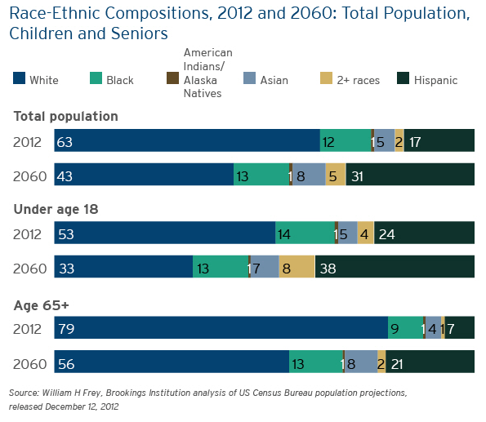
U.S. demographic trend requires targeted policies to promote education and training of racial/ethnic populations with high concentration of low-skilled workers.

Slide 19
How does skill level affect use of skills at work?

Slide 20
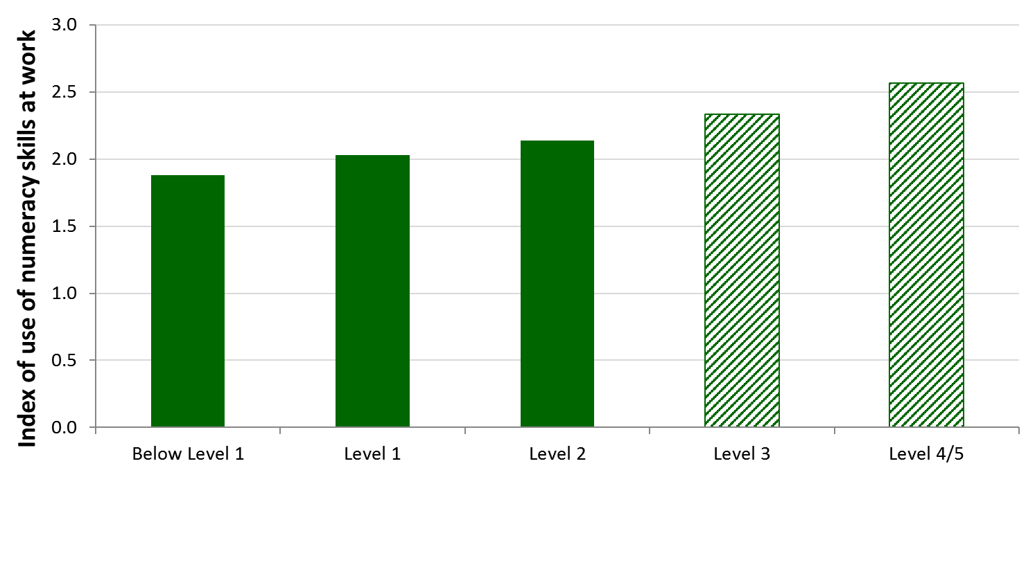

Compared to high-skilled, U.S. workers who are low-skilled in numeracy use their numeric skills at work less frequently.
Notes:
T-tests were done comparing the average writing index for each lower level vs. each higher level, comparing the average for Below Level 1 vs. Level 3; Below Level 1 vs. Level 4/5; Level 1 vs. Level 3; Level 1 vs. Level 4/5; Level 2 vs. Level 3; and Level 2 vs. Level 4/5.

Slide 21
What is the impact of skill level on income?

Slide 22
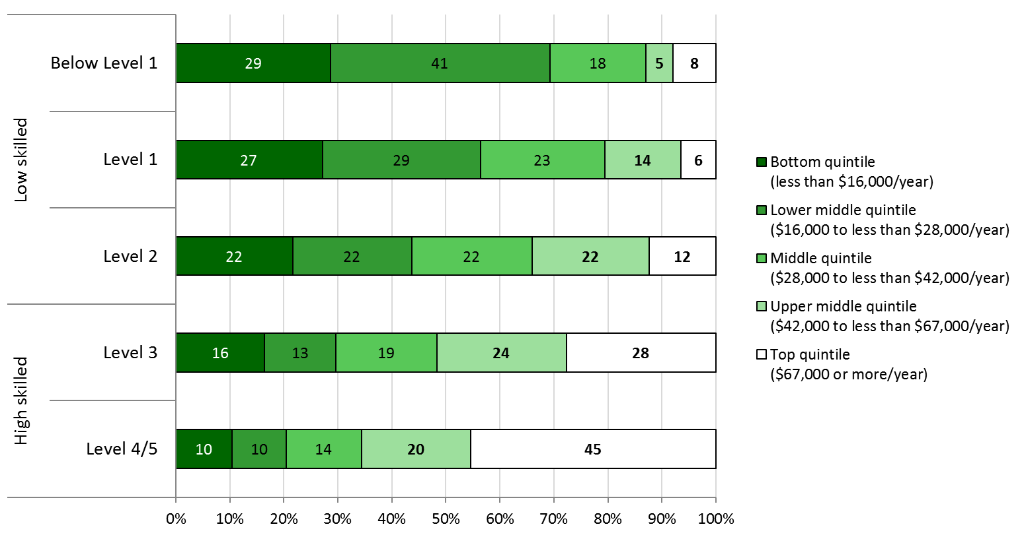
Low-skilled adults in numeracy are less likely than high-skilled adults to have earnings in the upper income quintiles.
Notes:
T-tests were done comparing the percentage in the combined top quintile + upper middle quintile for each lower level vs. each higher level, comparing the percentage for Below Level 1 vs. Level 3; Below Level 1 vs. Level 4/5; Level 1 vs. Level 3; Level 1 vs. Level 4/5; Level 2 vs. Level 3; and Level 2 vs. Level 4/5.

Slide 23
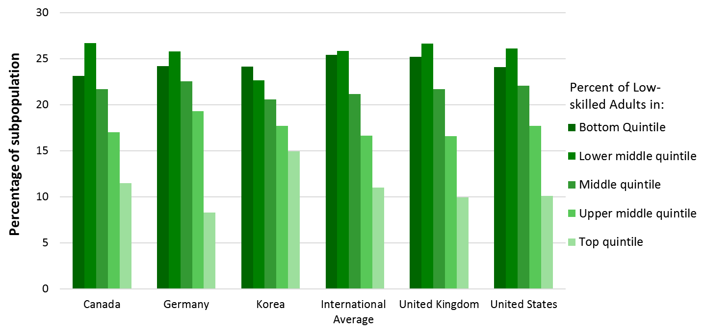
Similar to the international average, about one quarter of low-skilled adults in the U.S. have earnings in the bottom quintile of the income distribution.
Note: International Average includes Round 1 countries included in the National Center for Education Statistics PIAAC International Data Explorer (NCES PIAAC IDE).
Notes:
T-tests were done comparing the percentage of low-skilled adults (combined Below Level 1, Level 1, Level 2) in the U.S. in the bottom quintile of income to the percentage of low skilled adults (combined Below Level 1, Level 1, Level 2) in the International Average.
T-tests were also done comparing the percentage of low-skilled adults (combined Below Level 1, Level 1, Level 2) in the U.S. in the bottom quintile of income to the percentage of low-skilled adults (combined Below Level 1, Level 1, Level 2) in each other country displayed here. The percentages in these other countries were not significantly different than in the U.S.
Countries are listed in alphabetical order.

Slide 24
What is the relationship between skill level and participation in ongoing formal and non-formal education?

Slide 25
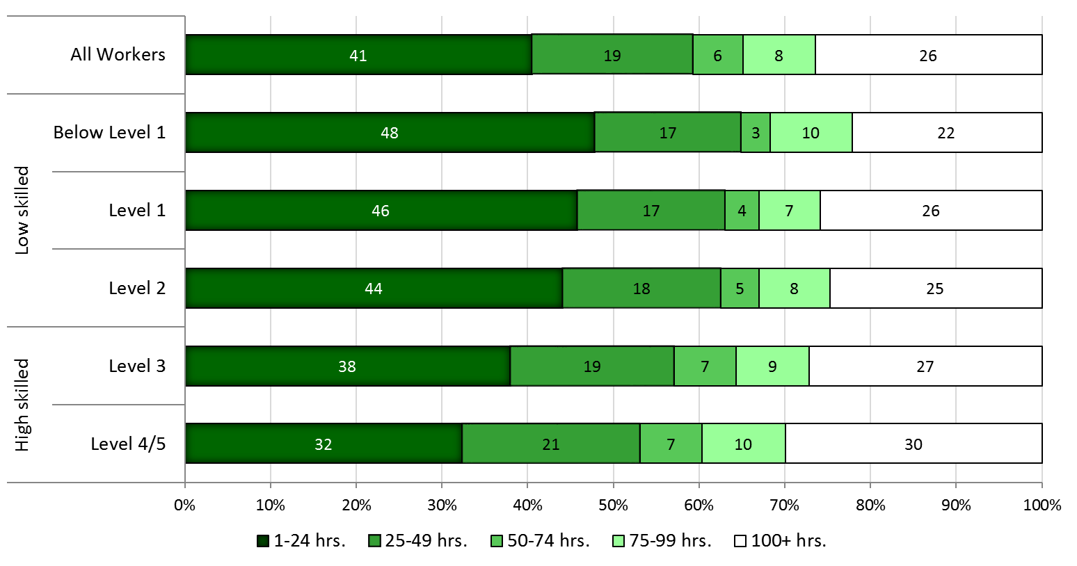
U.S. working adults with low skills in numeracy were more likely to participate in less than 25 hours of non-formal education in the past 12 months than those with higher skills in numeracy.
Notes:
T-test was done comparing the percentage with 1-24 hours of non-formal education in the low-skilled population (combined Below Level 1, Level 1, Level 2) vs. the percentage in the high-skilled population (combined Level 3, Level 4/5).

Slide 26
What are the constraints and enablers for participation in formal and non-formal education?

Slide 27
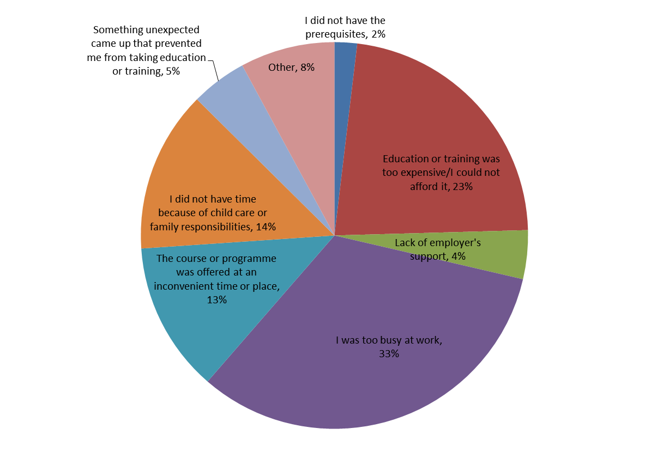
The most common reasons for U.S. working adults not participating in education and training are: too busy at work, cost, family responsibilities including childcare, and time that a course was offered.
Notes:
T-tests were done comparing the percentage for each most common reason (too busy at work, cost, family responsibilities including childcare, and time that a course was offered) vs. each less common reason (other, something unexpected came up, lack of employer’s support, did not have prerequisites) for the population of workers.

Slide 28
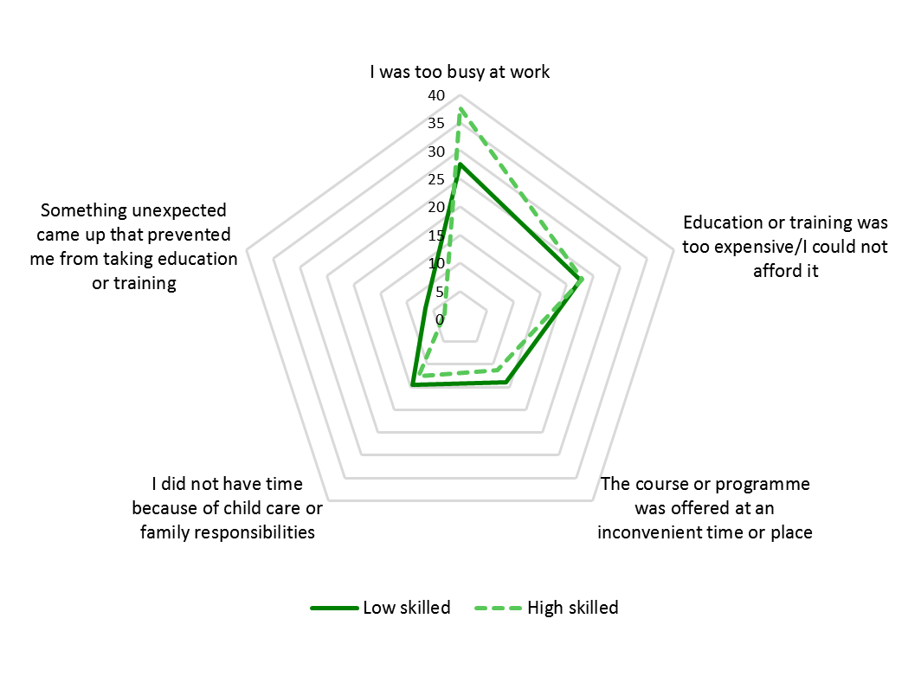
Compared to those with high skills in numeracy, low-skilled workers were less likely to state “too busy at work” as their top reason for not pursuing education and training.
Notes:
T-tests were done comparing the percentage of those who reported each of the reasons for not participating in education and training in the low-skilled population (combined Below Level 1, Level 1, Level 2) vs. the percentage in the combined high-skilled population (combined Level 3, Level 4/5).

Slide 29
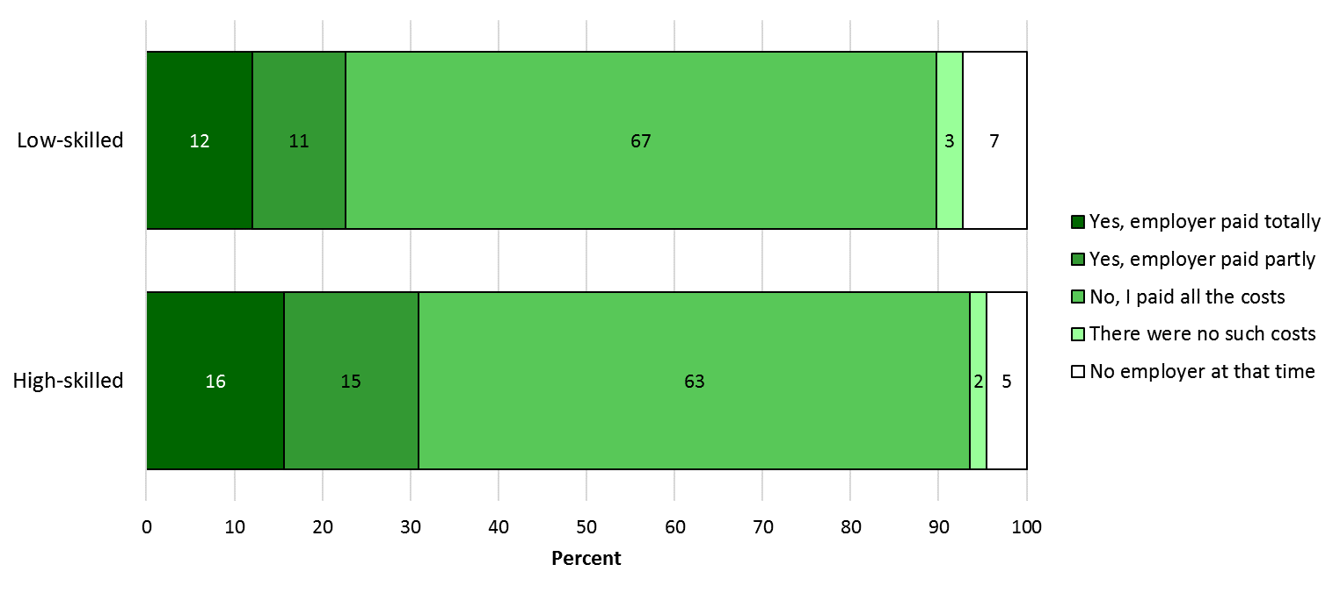
Employers were more likely to pay for expenses related to participation in formal education for workers with high skills in numeracy than those with low skills in numeracy.
Percent
Notes:
T-test was done comparing the percentage whose employers paid expenses (totally + partly paid) in the low-skilled population (combined Below Level 1, Level 1, Level 2) vs. the percentage in the high-skilled population (combined Level 3, Level 4/5).

Slide 30
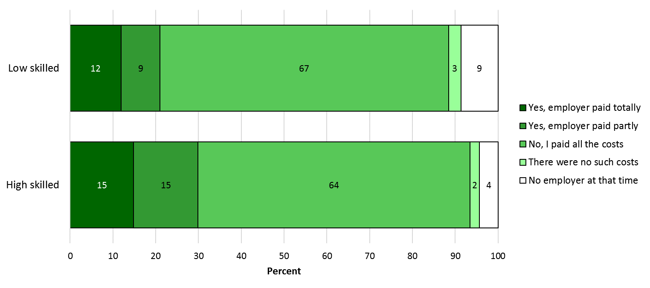
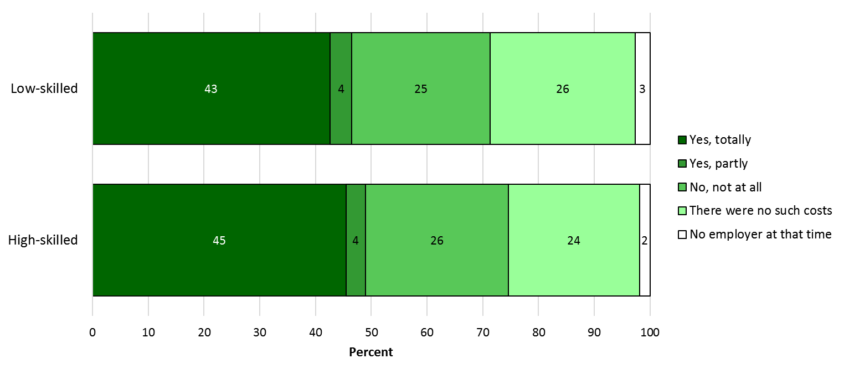
However, there was no measurable difference in how likely employers were to pay non-formal education expenses for workers with high skills than workers with low skills in numeracy.
Notes:
T-test was done comparing the percentage whose employers paid expenses (totally + partly paid) in the low-skilled population (combined Below Level 1, Level 1, Level 2) vs. the percentage in the high-skilled population (combined Level 3, Level 4/5).

Slide 31
Modules you can add here:
    Education and Skills Online
    More PIAAC Resources

