Slide 1
Overview of U.S. Results: Focus on Numeracy
From U.S. PIAAC 2012/2014 Data

Slide 2
How did we do compared to other countries?
Literacy
Numeracy
PS-TRE*
The U.S. ranked in roughly the middle of countries in Literacy.
The U.S. ranked lower than most other countries in Numeracy and Problem Solving in technology-rich environments.
Japan
Japan
Japan
Finland
Finland
Finland
Netherlands
Flanders-Belgium
Sweden
Sweden
Netherlands
Norway
Norway
Sweden
Netherlands
Estonia
Norway
Austria
Flanders-Belgium
Denmark
Denmark
Czech Rep.
Slovak Rep.
Czech Rep.
Slovak Rep.
Czech Rep.
Korea, Rep. of
Canada
Austria
Germany
Korea, Rep. of
Estonia
Canada
U.K.
Germany
Slovak Rep.
United States
Canada
Flanders-Belgium
Denmark
Cyprus
U.K.
Germany
Korea, Rep. of
Estonia
Austria
U.K.
Ireland
Cyprus
Poland
Poland
Poland
United States
United States
Ireland
Ireland
France
France
Spain
Italy
Italy
Spain
* Cyprus, France, Italy, and Spain did not participate.

Slide 3
The U.S. average literacy score (272) did not differ significantly from the international average (273)
Literacy
Japan
Finland
Netherlands
Scores on literacy ranged from 250 (Italy) to 296 (Japan)
U.S. scores were:
Lower than in 7 countries
Not significantly different than in 8 countries
Higher than in 6 countries
Sweden
Norway
Estonia
Flanders-Belgium
Czech Rep.
Slovak Rep.
Canada
Korea, Rep. of
U.K.
United States
Denmark
Germany
Austria
Cyprus
Poland
Ireland
France
Spain
Italy

Slide 4
Larger percentages of U.S. adults performed at the top (Level 4/5) and the bottom (Level 1 or below) of the distribution in literacy.
18%
16%
NOTE: United States data are the U.S. PIAAC 2012/2014 data. PIAAC 2012 international average based on all countries and regions that participated in PIAAC 2012 as reported in the 2012 First Look (NCES 2013-008).

Slide 5
These descriptions of the PIAAC Proficiency Levels for Literacy define what adults can do at each level.
Locate single piece of information in familiar texts.
Read relatively short digital, print or mixed texts to locate single text.
Identify, interpret, or evaluate one or more pieces of information and often require varying levels of inference.
Make matches between text and information that may require low level para-phrasing and drawing low-level inferences.
Perform multiple-step operations to integrate, interpret, or synthesize information from complex texts, and may require complex inferences.
Integrate information across multiple, dense texts; construct syntheses, ideas or points of view; or evaluate evidence based arguments.
Level 5 (376-500)
Level 4 (326-375)
Level 3 (276-325)
Level 2 (226-275)
Below Level 1 (0-175)
Level 1 (176-225)
Notes:
Look at these levels carefully: in US, our average is near the top of Level 2. THE OECD defines proficiency as Level 3.
Below Level 1: Individuals at this level can read brief texts on familiar topics and locate a single piece of specific information identical in form to information in the question or directive. They are not required to understand the structure of sentences or paragraphs and only basic vocabulary knowledge is required. Tasks below Level 1 do not make use of any features specific to digital texts.
Level 1: Individuals at this level can read relatively short digital or print continuous, non-continuous, or mixed texts to locate a single piece of information, which is identical to or synonymous with the information given in the question or directive. These texts contain little competing information. Adults performing at this level can complete single forms, understand basic vocabulary, determine the meaning of sentences, and read continuous texts with a degree of fluency.
Level 2: Individuals at this level can integrate two or more pieces of information based on criteria, compare and contrast or reason about information and make low-level inferences. They can navigate within digital texts to access and identify information from various parts of a document.
Level 3: Individuals at this level can understand and respond appropriately to dense or lengthy texts, including continuous, non-continuous, mixed, or multiple pages. They understand text structures and rhetorical devices and can identify, interpret, or evaluate one or more pieces of information and make appropriate inferences. They can also perform multi-step operations and select relevant data from competing information in order to identify and formulate responses.
Level 4: Individuals at this level can perform multiple-step operations to integrate, interpret, or synthesize information from complex or lengthy continuous, non-continuous, mixed, or multiple-type texts that involve conditional and/or competing information. They can make complex inferences and appropriately apply background knowledge as well as interpret or evaluate subtle truth claims or arguments.
Level 5: Individuals at this level can perform tasks that involve searching for and integrating information across multiple, dense texts; constructing synthesis of similar and contrasting ideas or points of view, or evaluating evidence and arguments. They can apply and evaluate logical and conceptual models, and evaluate the reliability of evidentiary sources and select key information. They are aware of subtle, rhetorical cues and are able to make high-level inferences or use specialized background knowledge.

Slide 6
The U.S. average numeracy score (257) was lower than the international average (269).
Numeracy
Japan
Finland
Numeracy scores ranged from 246 (Spain) to 288 (Japan)
U.S. scores were:
Lower than in 16 countries
Not significantly different than in 2 countries
Higher than in 3 countries
Flanders-Belgium
Netherlands
Sweden
Norway
Denmark
Slovak Rep.
Czech Rep.
Austria
Estonia
Germany
Canada
Cyprus
Korea, Rep. of
U.K.
Poland
United States
Ireland
France
Italy
Spain

Slide 7
About 3 in 10 U.S. adults performed at the bottom (Level 1 or below) of the distribution in numeracy.
28%
19%
NOTE: United States data are the U.S. PIAAC 2012/2014 data. PIAAC 2012 international average based on all countries and regions that participated in PIAAC 2012 as reported in the 2012 First Look (NCES 2013-008).

Slide 8
These descriptions of the PIAAC Proficiency Levels for Numeracy define what adults can do at each level.
Level 5
(376-500)
Perform basic tasks: counting, arithmetic operations with whole numbers.
Perform one-step tasks: count; sort; arithmetic operations; understanding simple percent (ex. 50%).
Perform 2 or more calculations, simple measurement; spatial representation; estimation; and interpret simple tables, graphs.
Understand & work with mathematical patterns, proportions, basic statistics expressed in verbal or numerical form.
Understand complex abstract mathema-tical and statistical ideas, embedded in complex texts, draw inferences; arguments or models; justify, reflect on solutions or choices.
Perform analysis, complex reasoning, statistics and chance; spatial relationships; and communica-ting well-reasoned explanations for answers.
Level 4
(326-375)
Level 3
(276-325)
Level 2
(226-275)
Below Level 1 (0-175)
Level 1
(176-225)
Notes:
Again – let’s look at levels. This time our average is solidly in the middle of Level 2. The OECD defines proficiency at Level 3 here as well.
Below Level 1: Adults at this level can only cope with very simple tasks set in concrete, familiar contexts where the mathematical content
is explicit and that require only simple processes such as counting; sorting; performing basic arithmetic operations with
whole numbers or money, or recognizing common spatial representations. Adults who score less than 176 points are
considered to be below Level 1.
Level 1: Adults at Level 1 can complete tasks involving basic mathematical processes in common, concrete contexts where the
mathematical content is explicit with little text and minimal distractors. They can perform one-step or simple processes
involving counting, sorting, basic arithmetic operations, understanding simple percents, and locating and identifying
elements of simple or common graphical or spatial representations.
Level 2: Adults at this level can successfully perform tasks that require identifying and acting upon mathematical information and
ideas embedded in a range of common contexts where the mathematical content is fairly explicit or visual with relatively
few distractors. The tasks may require applying two or more steps or processes involving, for example, calculations
with whole numbers and common decimals, percents and fractions; simple measurement and spatial representations;
estimation; or interpreting relatively simple data and statistics in texts, tables and graphs.
Level 3: Adults at Level 3 can successfully complete tasks that require an understanding of mathematical information that may
be less explicit, embedded in contexts that are not always familiar, and represented in more complex ways. They can
perform tasks requiring several steps and that may involve a choice of problem-solving strategies and relevant processes.
They have a good sense of number and space; can recognize and work with mathematical relationships, patterns, and
proportions expressed in verbal or numerical form; and can interpret and perform basic analyses of data and statistics
in texts, tables and graphs.
Level 4: At this level, adults understand a broad range of mathematical information that may be complex, abstract or embedded
in unfamiliar contexts. They can perform tasks involving multiple steps and select appropriate problem-solving strategies
and processes. They can analyze and engage in more complex reasoning about quantities and data, statistics and chance,
spatial relationships, change, proportions and formulae. They can also understand arguments and communicate well-reasoned explanations for answers or choices.
Level 5: Adults at Level 5 on the numeracy scale can understand complex representations, and abstract and formal mathematical
and statistical ideas, sometimes embedded in complex texts. They can integrate several types of mathematical information
where considerable translation or interpretation is required; draw inferences; develop or work with mathematical
arguments or models; and justify, evaluate and critically reflect upon solutions or choices.

Slide 9
The U.S. average score in digital problem solving* (274) was also lower than the international average (283).
PS-TRE
Scores ranged from 274 (U.S.) to 294 (Japan)
U.S. scores were:
Lower than in 16 countries
Not significantly different than in 1 other country
Higher than no other country
Cyprus, France, Italy, and Spain did not include this domain in their assessment
Japan
Finland
Sweden
Norway
Netherlands
Austria
Denmark
Czech Rep.
Korea, Rep. of
Germany
Canada
Slovak Rep.
Flanders-Belgium
U.K.
Estonia
Ireland
Poland
United States
* Officially problem solving in technology-rich environments (PS-TRE)

Slide 10
A higher proportion of U.S. adults are also at the lowest levels of digital problem solving.
64%
55%
NOTE: United States data are the U.S. PIAAC 2012/2014 data. PIAAC 2012 international average based on all countries and regions that participated in PIAAC 2012 as reported in the 2012 First Look (NCES 2013-008).

Slide 11
These descriptions of the PIAAC proficiency levels for digital problem solving define what adults
can do at each level.
Level 3
(341-500)
Tasks are well-defined involving use of only one function within a generic interface.
Tasks require little or no navigation, and only a few steps to access information for solving the problem. There are few monitoring demands.
Tasks require some navigation across pages and applications for solving the problem. Evaluating the relevance, some integration and inferential reasoning may be needed.
Task may involve multiple steps and operators, navigation across pages and applications. There are typically high monitoring demands, and evaluation of relevance and reliability of information.
Level 2
(291-340)
Level 1
(241-290)
Below Level 1 (0-240)
Notes:
Again, let’s look at these levels: the US average is 277 – at Level 1. The OECD defines proficiency here at Level 2.
Below Level 1: Below Level 1, adults can complete tasks in which the goal is explicitly stated and for which the necessary operations are performed in a single and familiar environment. They can solve problems whose solutions involve a relatively small number
of steps, the use of a restricted range of operators, and a limited amount of monitoring across a large number of actions.
Level 1: At Level 1, adults can complete tasks in which the goal is explicitly stated and for which the necessary operations are
performed in a single and familiar environment. They can solve problems in the context of technology-rich environments
whose solutions involve a relatively small number of steps, the use of a restricted range of operators, and a limited
amount of monitoring across a large number of actions.
Level 2: At Level 2, adults can complete problems that have explicit criteria for success, a small number of applications, and
several steps and operators. They can monitor progress towards a solution and handle unexpected outcomes or impasses.
Level 3: Adults at Level 3 can complete tasks involving multiple applications, a large number of steps, impasses, and the discovery
and use of ad hoc commands in a novel environment. They can establish a plan to arrive at a solution and monitor its
implementation as they deal with unexpected outcomes and impasses.

Slide 12
More Results for Numeracy
You can continue with this slide presentation to see more results for numeracy for the whole population or
You can move right on to one of the Key Populations and Issues Modules here.

Slide 13
More Results for Numeracy

Slide 14
The U.S. average numeracy score in 2012 is lower than in 2003.
*p < .05. Average score is significantly different from PIAAC.

Slide 15
U.S. adults at every education level are below the international average in numeracy.
*p < .05. U.S. average score is significantly different from PIAAC international average.
Note: International averages exclude Australia and the United Kingdom.

Slide 16
Employed adults in the U.S. had lower average numeracy scores than their peers internationally.
*p < .05. U.S. average score is significantly different from PIAAC international average.
Note: International averages exclude Australia.

Slide 17
U.S. Black and Hispanic adults had lower average numeracy scores than White adults.
*p < .05. Average score is significantly different from White average.

Slide 18
U.S. adults in each age group, except for ages 55-65, scored below the international average for their age group in numeracy.
*p < .05. U.S. average score is significantly different from PIAAC international average.
Note: International averages exclude Australia.

Slide 19
Larger percentages of U.S. adults age 25-34 and 35-44 performed at the top level (4/5) in numeracy than U.S. adults age 55-65 and 66-74.
U.S. numeracy proficiency levels, by age:

Slide 20
U.S. adults at each income level, except for the top quintile, scored lower in numeracy than the international average.
*p < .05. U.S. average score is significantly different from PIAAC international average.
Note: International averages exclude Australia, Austria, Canada, and Germany.

Slide 21
The gaps in numeracy scores in the U.S. are larger by educational attainment than the international average.
U.S.
International
U.S.
International
U.S.
International
U.S.
International
Education
Income
Employment
Occupation
Average
score
Education
Graduate or
professional
degree
Below High
School
Income
Top quintile
Bottom
quintile
Employment
Employed
Unemployed
Occupation
Skilled
Unskilled
Note: All international averages exclude Australia. For “Education,” international averages exclude the United Kingdom. For “Income,” international averages exclude Austria, Canada, and Germany.

Slide 22
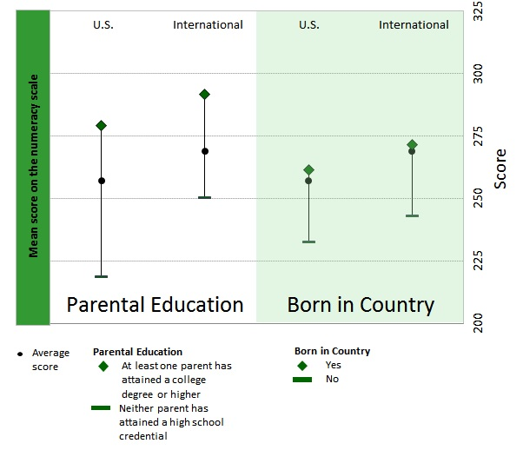
The gaps in numeracy scores in the U.S. are larger than the international average by parental education, but not different by nativity status.
Note: All international averages exclude Australia. For “Born in Country,” international averages exclude Austria.

Slide 23
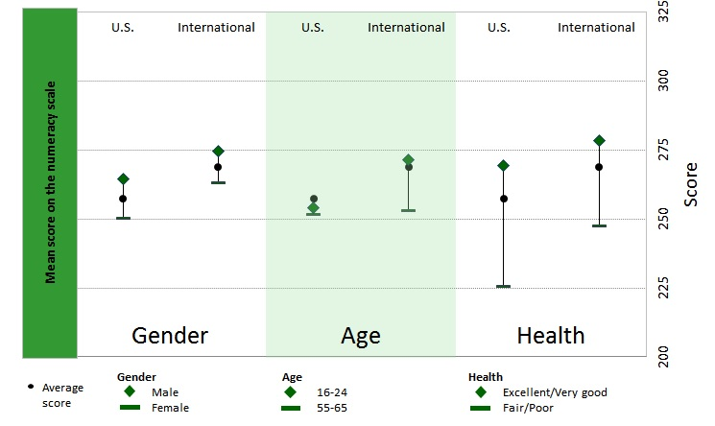
In numeracy, the gap in the U.S. is similar to the international average by gender, smaller by age, and larger by health status.
Note: All international averages exclude Australia. For “Health,” international averages exclude Canada.

Slide 24
Slide Modules you can add to your presentation:
Sample tasks
Education and Skills Online
More PIAAC Resources
Modules focused on specific populations and issues.

