Slide 1
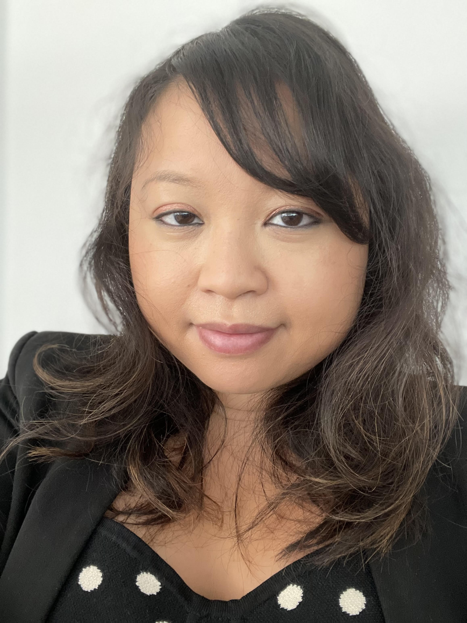
The Importance of Skills and Qualifications for College-Educated Immigrants’ Economic Integration
Welcome to the PIAAC Research Webinar Series
Thursday, December 15th, 2022 | 12:30 PM EST
Moderated by:
Dr. Monica Mean, Senior Evaluation Specialist, U.S. Department of Labor

Slide 2




The Importance of Skills and Qualifications for College-Educated Immigrants’ Economic Integration
Presenters:
Dr. Jeanne Batalova
Senior Policy Analyst and Manager of the MPI Migration Hub
Migration Policy Institute
Michael Fix
Senior Fellow
Migration Policy Institute
Notes:
ENGAGE EVERYONE
Consider participants’ needs (e.g., visual, auditory, sensory, cognitive, physical, and language). Establish meeting norms to encourage participation. Ask participants if they can see and hear. Designate a meeting monitor to address audio/visual issues and respond to virtual participants’ comments and questions
BE HEARD AND SEEN
Project your voice when speaking. Permit one speaker at a time and avoid overlapping and sidebar conversations. Allow people to see your facial expressions and body language clearly. Position everyone so they can be seen on-screen. For virtual participants, promote webcam use.
ACKNOWLEDGE SPEAKER
Raise your hand or provide another auditory or visual cue before speaking to identify yourself as the speaker. State your name for those who cannot see you. When asking for questions or comments, allow 5 to 7 seconds for participants to unmute phones. Be comfortable with wait time.
MAXIMIZE MICROPHONES
Microphone(s) are needed for face-to-face and virtual meetings and are critical for engaging remote colleagues and persons with hearing loss. Set up microphone(s) for the facilitator and attendees and ensure that hand-held microphones are available for groups with audience participation. Ensure speakers are near a microphone.
MINIMIZE NOISE
Avoid moving around or shuffling materials on a desk. Eliminate crunching or chewing noises and loud typing, which interfere with sound quality for virtual participants and are amplified by microphones and hearing aids. Speak from a stationary position to keep the audio clear. Mute your phone or computer when not speaking.
MAXIMIZE VISUAL DISPLAYS
E-mail materials in advance of meeting. Display meeting documents on-screen, and capture main discussion points verbally and visually by taking notes or using the “chat box,” Skype, or other means. If a participant asks for clarification, rephrase the content instead of repeating it. Assign a meeting notetaker so that the meeting leader and monitor can focus on engagement. Notes are also helpful for people with hearing loss who may not have heard the content.

Slide 3
The Skills and Economic Outcomes of Immigrant and U.S.-Born College Graduates
Jeanne Batalova and Michael Fix
PIAAC Research Webinar Series
December 15, 2022

Slide 4
MPI Programs & Initiatives
U.S. Immigration Policy Program
National Center on Immigrant Integration Policy
Latin America & Caribbean Initiative
Transatlantic Council on Migration
Migration Data Hub
International Program
Migration Information Source

Slide 5
Agenda
MPI’s Immigrant Skills & Underutilization Research
Context: Demographic & Labor Force Trends
PIAAC Data: A Unique Analytical Lenses
Key Findings
Takeaways

Slide 6
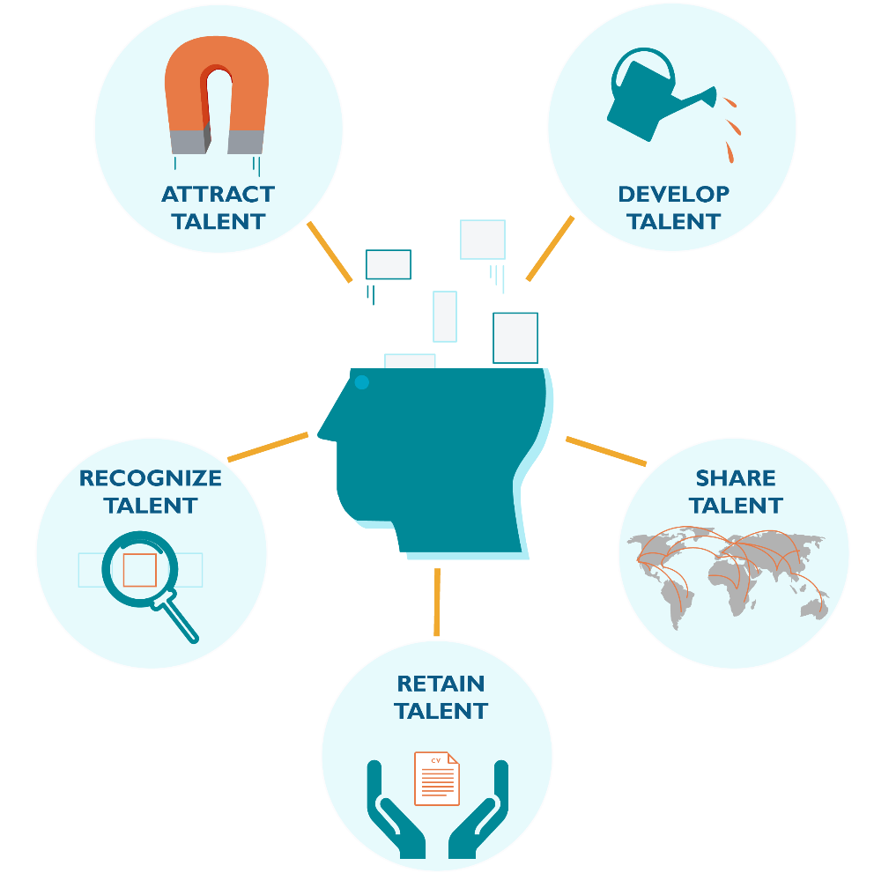
MPI Skills & Talent Framework

Slide 7
Demographic & Labor Force Context
Rising educational level of U.S. adults, including immigrants
  Almost half of recently arrived immigrants have BA/higher
Slower population growth, population aging, rising mortality among whites
  Immigrant-origin population: a key driver of U.S. labor force
Growing racial and ethnic diversity
Brain waste: 2 million underemployed college-educated immigrants
  Cost: $40B in lost wages; $10B in lost taxes

Slide 8
PIAAC Data & Study Population
Study motivation
PIAAC data (2012/2014/2017): A unique data source
  Direct cognitive skills assessment
  Economic outcomes, incl. job quality
Study population
  Adults ages 25-65 with at least a bachelor’s degree

Slide 9
Research Questions
What are the demographic and educational characteristics, cognitive skills, and labor market outcomes of college-educated adults?
What is the relationship between the economic integration outcomes of college-educated graduates and their cognitive skills?
How do the relationships between the skills and economic integration outcomes vary by immigrants’ characteristics?

Slide 10
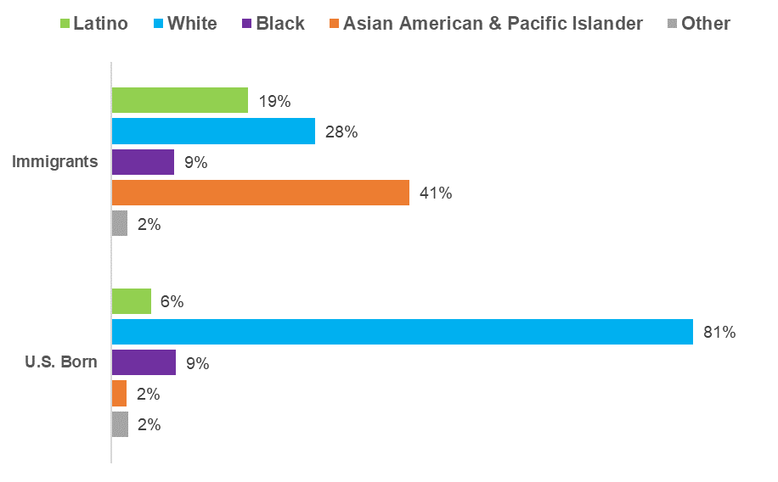
Immigrants Are More Racially and Ethnically Diverse
Source: Authors’ tabulation of pooled 2012/2014/2017 PIAAC, provided by the National Center for Education Statistics (NCES).

Slide 11
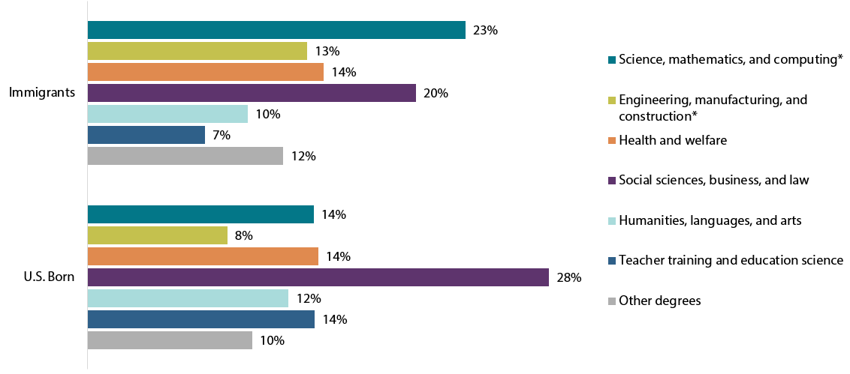
Immigrants Are More Likely to Have Advanced Degrees and Major in STEM
Source: Authors’ tabulation of pooled 2012/2014/2017 PIAAC, provided by the National Center for Education Statistics (NCES).

Slide 12
Key Terms’ Definitions
Immigrants: Persons born outside of the United States
College educated: Adults (25-65) with a BA degree or higher
Literacy/numeracy/digital skills: What adults know and can do with the information
Labor force participation: Share employed/unemployed among all adults (25-65)
Monthly wage: Average monthly earnings of full-time workers with positive earnings
Skill underutilization: Share of college-educated workers in the civilian labor force who reported that they were in jobs requiring no more than a high school education or that they were unemployed
Job quality of workers: Questions about workers’ autonomy; managing others; types of employment contracts; number of jobs held; job satisfaction; skills to cope with more demanding duties

Slide 13
Cognitive Skills: Immigrants Lag Behind
High proficiency level in literacy: 53% immigrants vs 76% U.S. born
High proficiency level in numeracy: 54% immigrants vs 64% U.S. born
High proficiency level in digital skills: 35% immigrants vs 54% U.S. born
BUT: PIAAC is a test in English only
  U.S.-educated immigrants’ scores are higher

Slide 14
Economic Outcomes: Immigrants Fare Well
Economic outcomes: labor force participation, monthly earnings, skill underutilization, and self-assessed job quality
Labor force participation: 86% immigrants vs 89% U.S.-born adults
Monthly earnings of full-time workers
  $7,100 immigrants vs $6,500 U.S. born
Underemployed: 20% for both immigrant and U.S.-born adults
Higher cognitive skills ➔ Better economic outcomes

Slide 15
Job Quality: Immigrants Fare Well
Source: Authors’ tabulation of pooled 2012/2014/2017 PIAAC, provided by the National Center for Education Statistics (NCES).

Slide 16
Quick Summary Takeaways
Higher levels of human capital are associated with better economic outcomes for college graduates
College-educated immigrant population is growing in labor market prominence
Most immigrant college graduates, especially those who are U.S. educated, are integrating successfully in the U.S. labor market
1/5 of college graduates are underutilized ➔ need to address underemployment

Slide 17
Policy Interventions
Opportunities to acquire professional English and communications skills in a professional environment
Recognition of education and work experience obtained abroad
“Bridge” courses: Filling gaps in workers’ prior schooling and experience
Alteration of inefficient occupational licensing requirements with positive spillover effects for underemployed U.S.-born workers

Slide 18
Change in the Air: Promising Examples
NY Presbyterian Hospital and Upwardly Global: paid mid-career internship for healthcare, IT, and other professionals
Minnesota’s IMG Assistance Program ➔ helping int’l trained doctors + increasing access to health providers in underserved areas
Washington State: “Limited” physician licensure
Virginia: Provisional licenses for teachers
Federal level: The Bridging the Gap for New Americans Act of 2022

Slide 19
Additional Resources
  Leaving Money on the Table: The Persistence of Brain Waste among College-Educated Immigrants
  The Integration of Immigrant Health Professionals: Looking beyond the COVID-19 Crisis
  Navigating the Future of Work: The Role of Immigrant-Origin Workers in the Changing U.S. Economy
  How Does Immigration Fit into the Future of the U.S. Labor Market?
  Through an Immigrant Lens: PIAAC Assessment of the Competencies of Adults in the United States

Slide 20

Contact Us
Jeanne Batalova
Senior Policy Analyst
jbatalova@migrationpolicy.org
@JeanneBatalova
Michael Fix
Senior Fellow
mfix@migrationpolicy.org

Slide 21


MPI seeks to improve immigration and integration policies through authoritative research and analysis, opportunities for learning and dialogue, and the development of new ideas to address complex policy questions. For more info, please visit: https://www.migrationpolicy.org/.
And sign up to receive news about MPI or MPI Europe research, publications, and events on topics that are of interest: https://www.migrationpolicy.org/signup.
202-266-1940
info@migrationpolicy.org
@MigrationPolicy
@MigrationPolicyInstitute
Migration Policy Institute

Slide 22
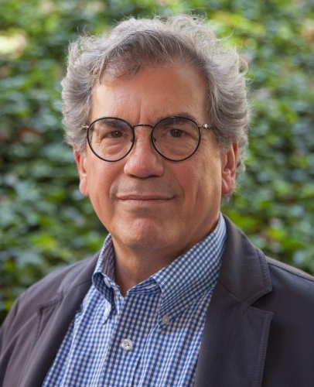
The Importance of Skills and Qualifications for College-Educated Immigrants’ Economic Integration
And now a discussion with:
Roberto Suro
Professor
University of Southern California
Notes:
ENGAGE EVERYONE
Consider participants’ needs (e.g., visual, auditory, sensory, cognitive, physical, and language). Establish meeting norms to encourage participation. Ask participants if they can see and hear. Designate a meeting monitor to address audio/visual issues and respond to virtual participants’ comments and questions
BE HEARD AND SEEN
Project your voice when speaking. Permit one speaker at a time and avoid overlapping and sidebar conversations. Allow people to see your facial expressions and body language clearly. Position everyone so they can be seen on-screen. For virtual participants, promote webcam use.
ACKNOWLEDGE SPEAKER
Raise your hand or provide another auditory or visual cue before speaking to identify yourself as the speaker. State your name for those who cannot see you. When asking for questions or comments, allow 5 to 7 seconds for participants to unmute phones. Be comfortable with wait time.
MAXIMIZE MICROPHONES
Microphone(s) are needed for face-to-face and virtual meetings and are critical for engaging remote colleagues and persons with hearing loss. Set up microphone(s) for the facilitator and attendees and ensure that hand-held microphones are available for groups with audience participation. Ensure speakers are near a microphone.
MINIMIZE NOISE
Avoid moving around or shuffling materials on a desk. Eliminate crunching or chewing noises and loud typing, which interfere with sound quality for virtual participants and are amplified by microphones and hearing aids. Speak from a stationary position to keep the audio clear. Mute your phone or computer when not speaking.
MAXIMIZE VISUAL DISPLAYS
E-mail materials in advance of meeting. Display meeting documents on-screen, and capture main discussion points verbally and visually by taking notes or using the “chat box,” Skype, or other means. If a participant asks for clarification, rephrase the content instead of repeating it. Assign a meeting notetaker so that the meeting leader and monitor can focus on engagement. Notes are also helpful for people with hearing loss who may not have heard the content.

